Slide 1

ORRVLLE UTILITIES
2017 Annual Report
Jeff Brediger, Director of Utilities
Notes:
Presentation to Utility Board 4/9/18. Presented to W x/x/x, WW x/x/xx, Power Plant x/x/xx, Electric Distribution/others x/x/xx.
Appointed Director in August 2009. I have been with Orrville Utilities for 32 years and in the utility sector for over 37 years.

Slide 2
Highlights
Total Utility expenditures, $42M
New Power Plant operation & labor reorganization to comply with new EPA regulations
Water & Wastewater rate increases
Board approved electric rate stabilization, $731k to freeze rates entire year
Emergency repair of main sewer line
Last hydro project in operation
US Supreme Court denial of appeal on EPA rule
2 solar sites constructed
Notes:
Power Plant transitioned very well. Hit all transmission peaks to receive maximum credits. More workforce training is in progress.
New W&WW rate plans will better position both utilities for the next 5 years.
Over 800’ of 36” concrete pipe on Apple Lane required replacement due to unexpected corrosion from a malfunctioning industrial pretreatment plant.
An appeal related to an EPA regulation that caused us so much pain went all the way to the US Supreme Court. Unfortunately, they did not want to take it up.

Slide 3
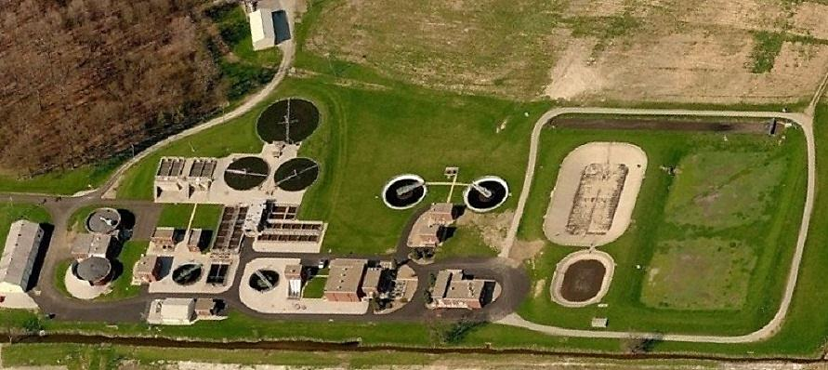
Aerial View of Plant
2MW Solar site located south of creek
Notes:
For City Council presentation (insert after slide 2)
Wastewater Utility site.
AMP’s 3 peaking diesel units (5.5MW) are just to the north of the grounds.
One of the two new solar sites is located south of the plant (across the creek) .

Slide 4
Orrville Wastewater Plant
Bob Auten, Superintendent
Established in 1908
Current facility constructed in 1951
Major expansions in 1969 and 1989
2.1 Million Gallons Average Flow per day
7.1 Million Gallons Maximum Flow per day
42 Miles of sewer lines, 8-42”
Treated over 800M gallons of wastewater
Operating budget, $2.3M (Capital projects $280k)
Notes:
This facility manages the most complex and dynamic processes of all 3 utilities.
We manage seven Industrial Pretreatment programs-Orrville must (required by law) enforce federal, state and local industry specific discharge limits and rules for the EPA.
Bob has been with us 32 yrs.

Slide 5
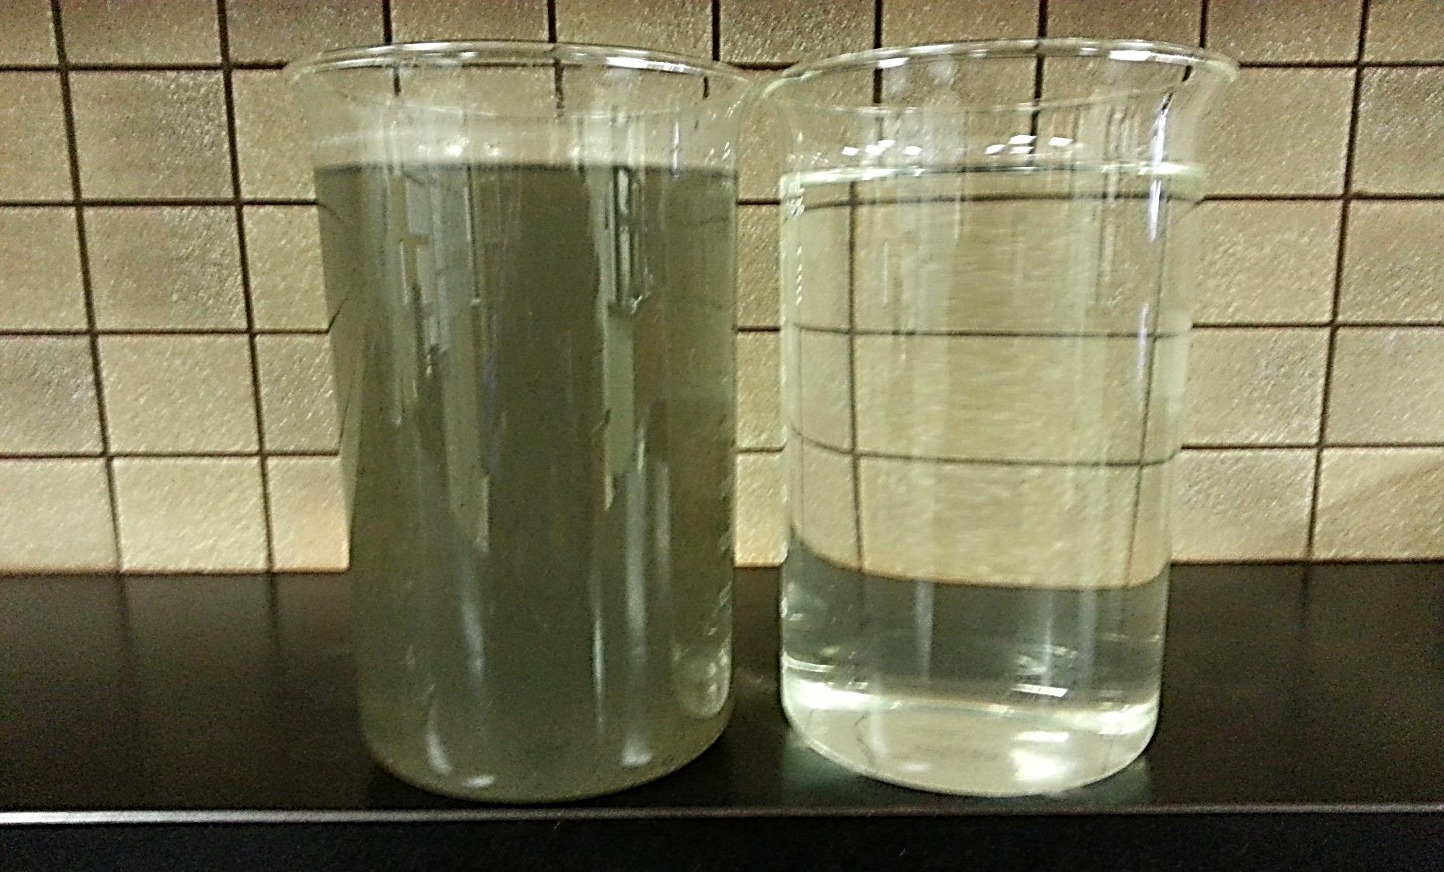
Influent Effluent
Notes:
Typically the way ‘it’ comes into the facility for processing after we pre-screen & grind it up.
The water (effluent) discharged into the creek is better (higher quality) than what’s typically flowing in it.

Slide 6
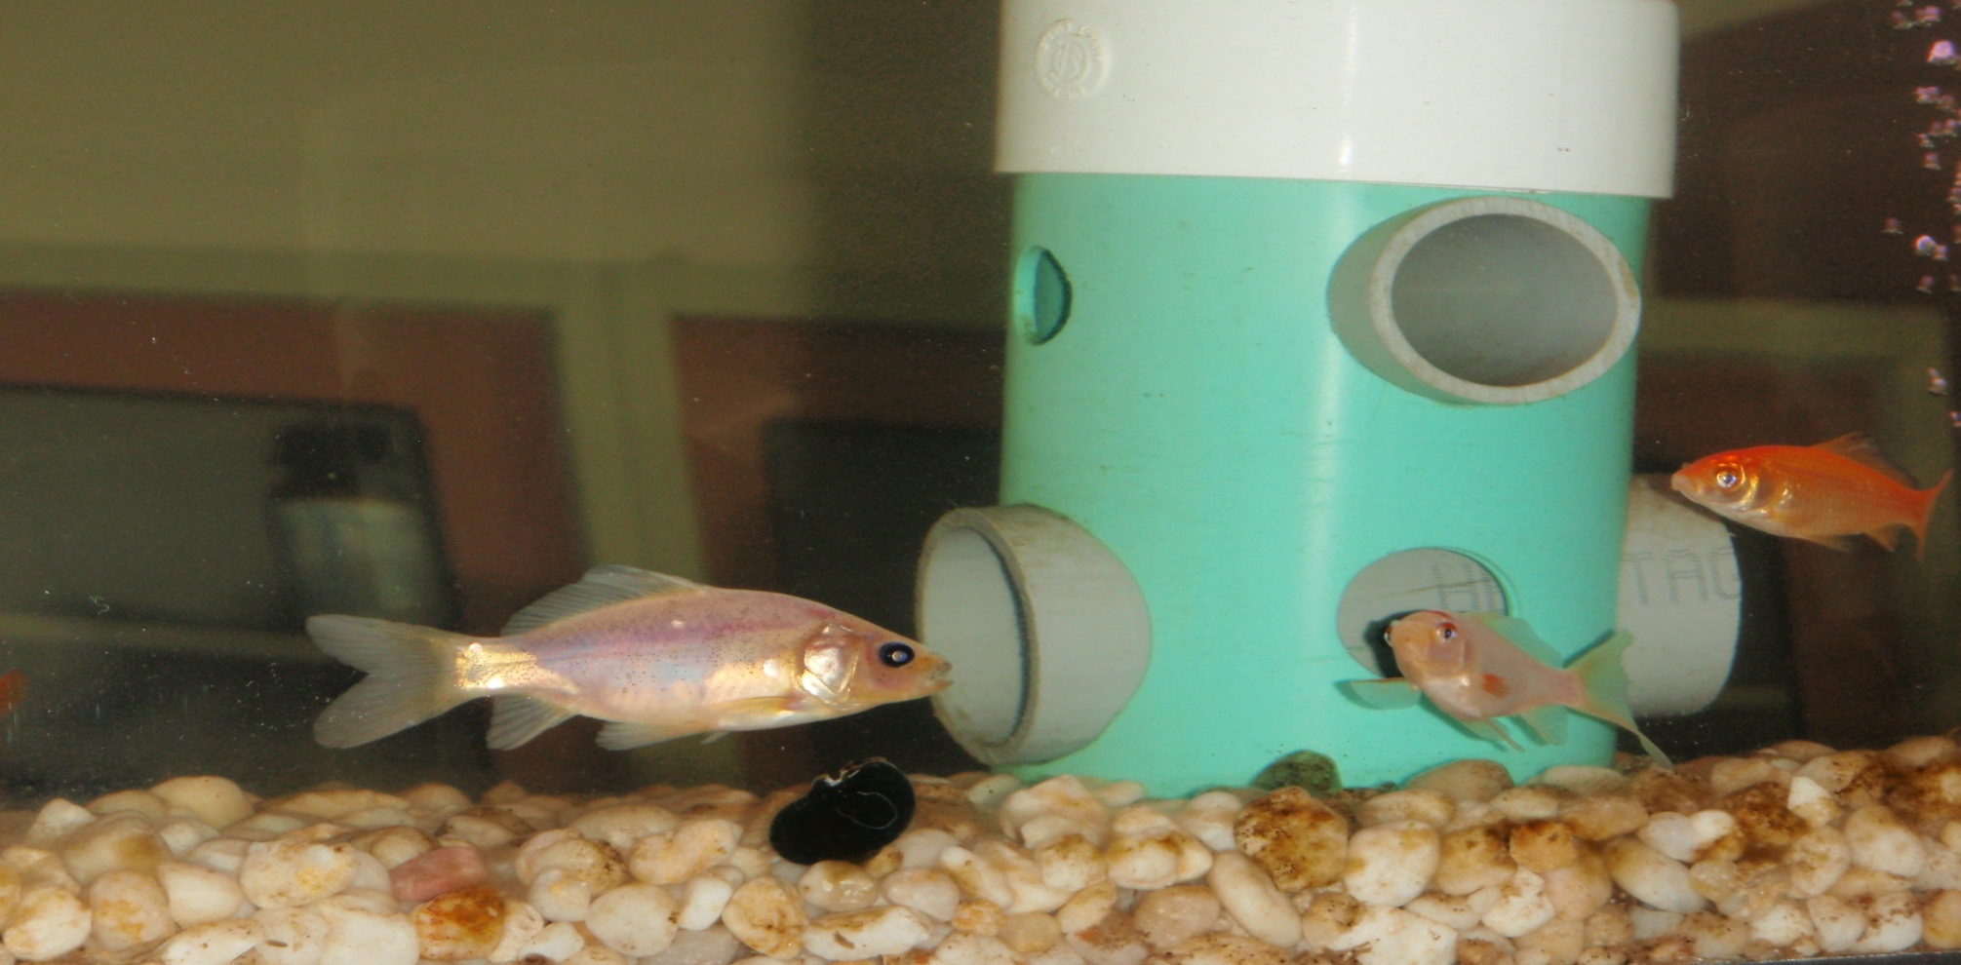
In-Line Fish Tanks, periodic bio-assays (using aquatic life), chemical and physical testing is used to confirm effluent quality to meet or exceed EPA standards before discharging to the creek.
Notes:
In addition to lab tests, we also monitor daphnia (called water fleas which are small aquatic planktonic crustaceans) which are even more sensitive to water quality.
The final effluent also flows thru this tank and a pond in front of the office entrance.

Slide 7
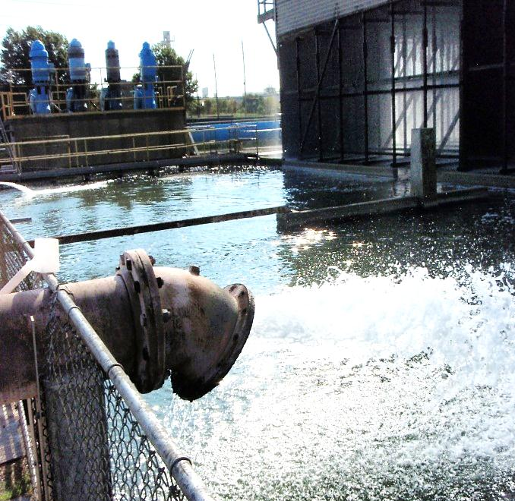
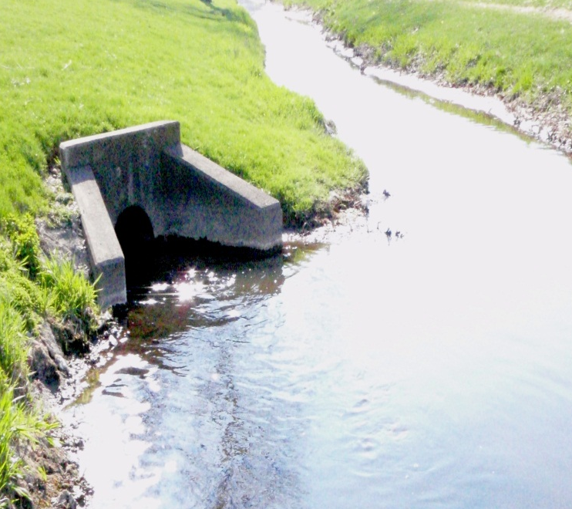
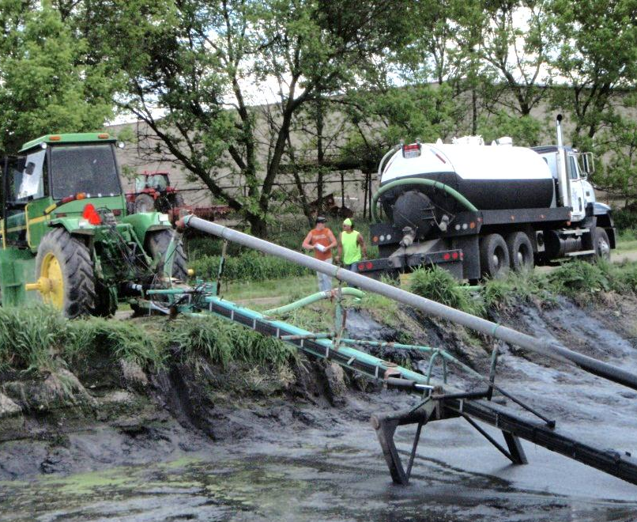
Discharge Points
Power Plant
Minimal Gallons/Day
Little Chippewa Creek 2,100,000 Gallons/Day
Private Farms (Sludge)
1M Gallons/Year
(250 Dry Tons)
Notes:
Re-use at Power Plant is mainly cooling water supply saving a valuable resource (since 1995). We were the first utility in the state to recycle this way. New EPA operating limits and regulations make it difficult to use this source today (go figure). Water is now mainly supplied by the Water Plant.
New EPA discharge regulations and changes in plant operation basically eliminated this option in 2016. Used to be around 200,000 gal/day.
Creek discharge is under strict Federal & State EPA limits.
Over 1 million gallons of sludge is properly disposed of each year. Land treatment, monitoring and application site rules are required.

Slide 8
Notes:
Based on our average load and large industrial base, we treat the equivalent of a city with a population of 35,000.
From Brenda’s DOE report.

Slide 9
Notes:
Not separately metered (except food processors and some industries). Residential usage is based on metered water usage.
Similar to 2016 except interdepartment which was a lot higher due to changes at the Power Plant.
Residential $914,676, Food $589,936, Commercial/Industrial $408,575, Interdepartment is Electric (main source) & Water dept’s $79,868.
From Brenda’s DOE report.

Slide 10
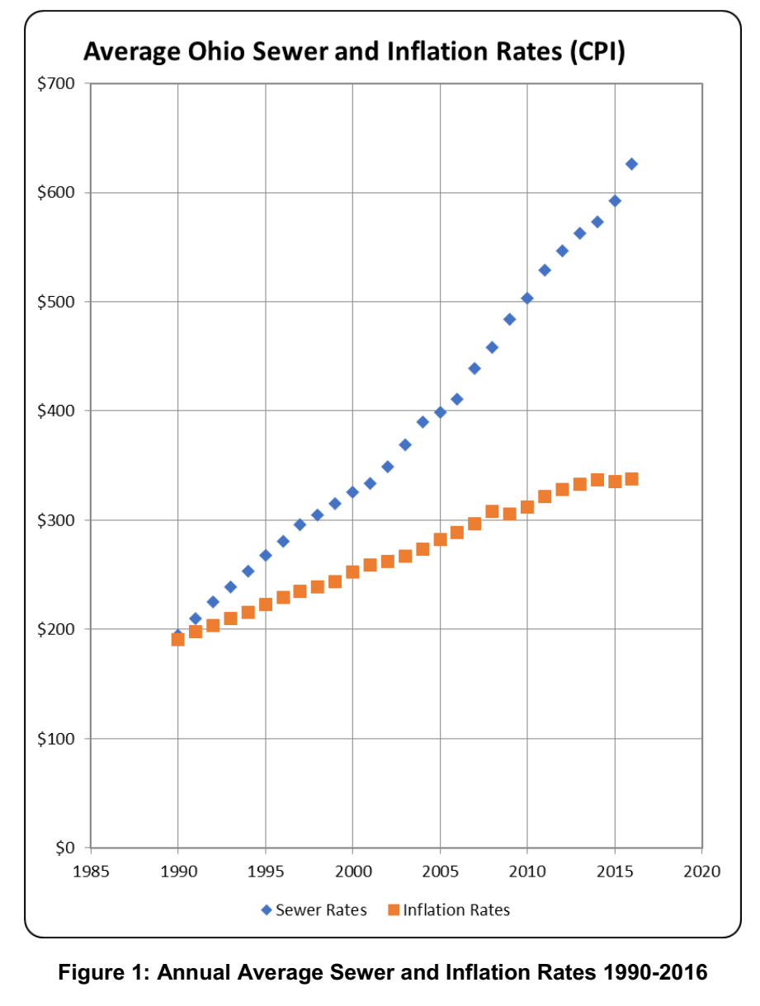
Orrville $517
Notes:
Our rates are below State average. State average $661, up 1.5% from 2015, 40% reported increases. Rates are calculated based on State average volumes (usage, 7,756 gallons per month or 1,037 cubic feet per month) for comparative purposes.
Most of our customers bills are lower due to actual lower usage.
New rate structures are in place for next 5 years. Rates are reviewed annually.
Source 2016 Ohio EPA survey.

Slide 11
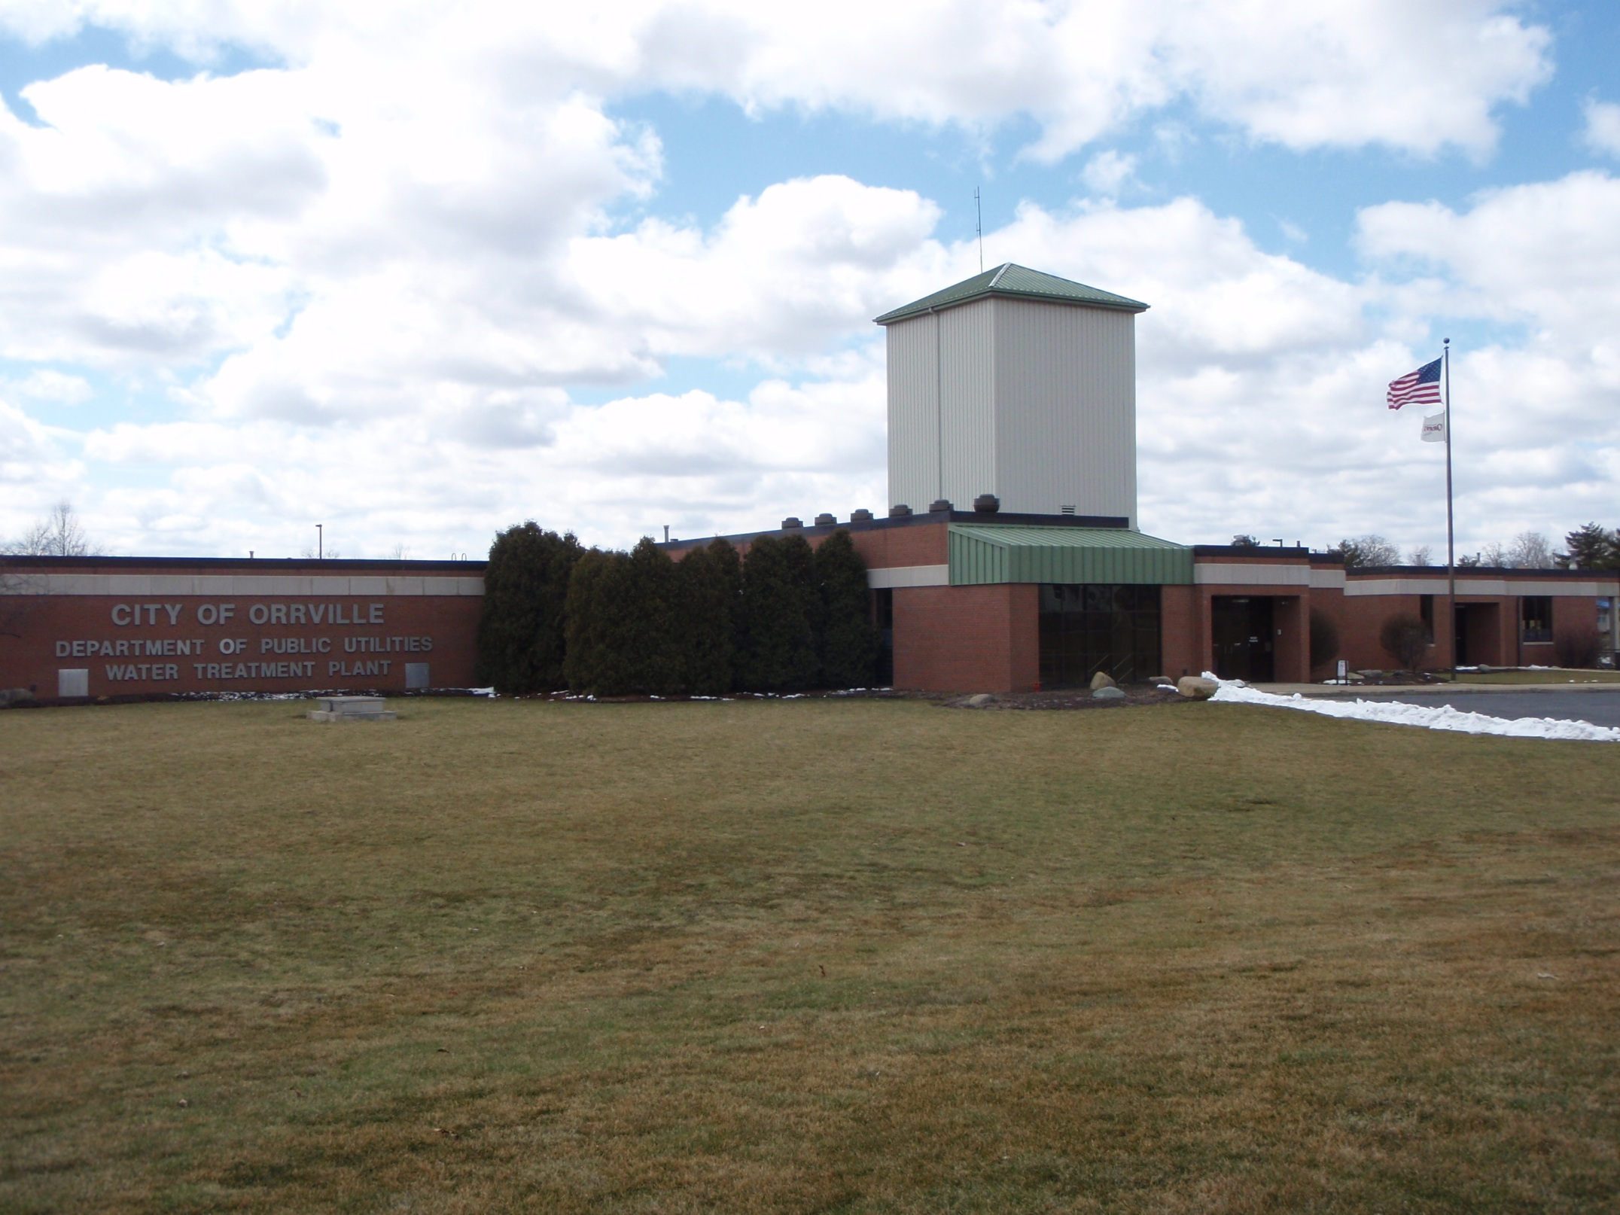
Notes:
For City Council presentation (insert after slide 10)
Water Utility.
Raw water from underground wells is pumped to the Water Plant then proceeds to lime softening, stabilization, re-carbonation, filtration, fluoridation and chlorination processes before coming to your faucet.
Fluoridation started in 1958. Once started, we can not stop per EPA regulations.

Slide 12
Orrville Water Plant
Todd Fetty, Superintendent
Oldest Utility, established in 1894
New Water Treatment Plant constructed in 1997 with an EPA approved capacity of 3.7 MGD, cost $13M
In 2009, received EPA approval for an increased capacity of 6.0 MGD
Treated an average of 1.9 million gallons per day
Operating budget, $2.4M
Notes:
The City was incorporated in 1864.
The Water Plant is designed to supply 100% of the water requirements to the Power Plant.

Slide 13
Supply & Distribution System
11 wells
61 miles of water lines (sizes 4” – 16”)
2 booster pump stations
3 elevated towers (West & South 150,000 gallons, Central 275,000 gallons)
2 underground tanks (1M gallon capacity each)
1 clear well tank (800,000 gallon capacity)
3,700 customers
950 valves
450 fire hydrants
Notes:
Central (downtown) tower built in 1938, West & South towers built in 1973.
North 1M gallon underground tank built in1974, South 1M gallon underground tank built in 1986 located at west tower site.
Can store enough for about 2 days (at 2M/day).

Slide 14
2016
Notes:
Power Plant was the largest customer and had accounted for over 30% of revenues in prior years. Only 9% in 2017 (21% in 2016). This was the main driver behind the rate changes.
The Commercial share increased notably in 2012 after Smuckers abandoned their wells as part of their new production facility and became a 100% user of Orrville’s water.
From Brenda’s DOE report.

Slide 15
Notes:
Units in cu. ft. x100
Power Plant usage was 2-3 times higher prior to the EPA’s mandated changes in 2016. Will be even lower in 2018.
From Industrial Customer Usage report.

Slide 16
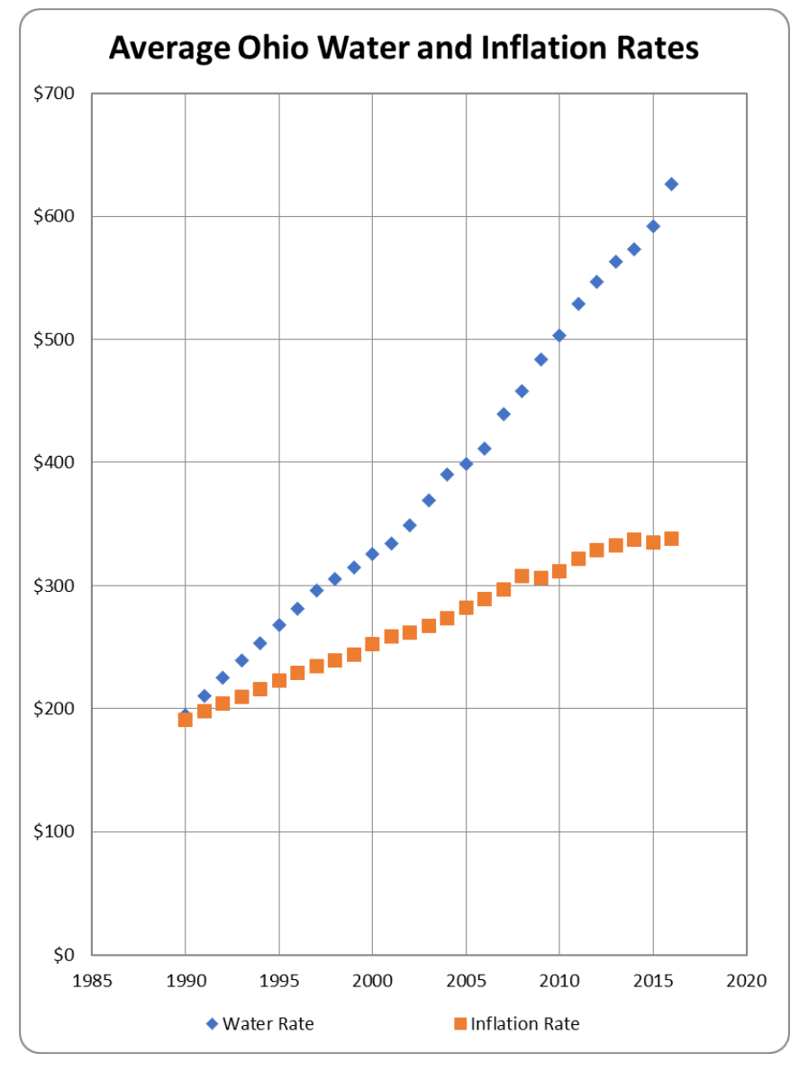
Orrville $631
Notes:
Our rates are slightly above State average of $628 for the first time due to changes at the Power Plant.
40% of surveys reported increases in rates.
Rates are calculated based on State average volumes (usage, 7,756 gallons per month or 1,037 cubic feet per month) for comparative purposes.
Most of our customers bills are lower due to lower usage.
New rate structure is in place for next 5 years. Rates are reviewed annually.
A big project in 2018 is replacing the water main on High St (Crownhill to Main St) in July, $1.6M & painting the west water tower.
Source 2016 Ohio EPA survey.

Slide 17
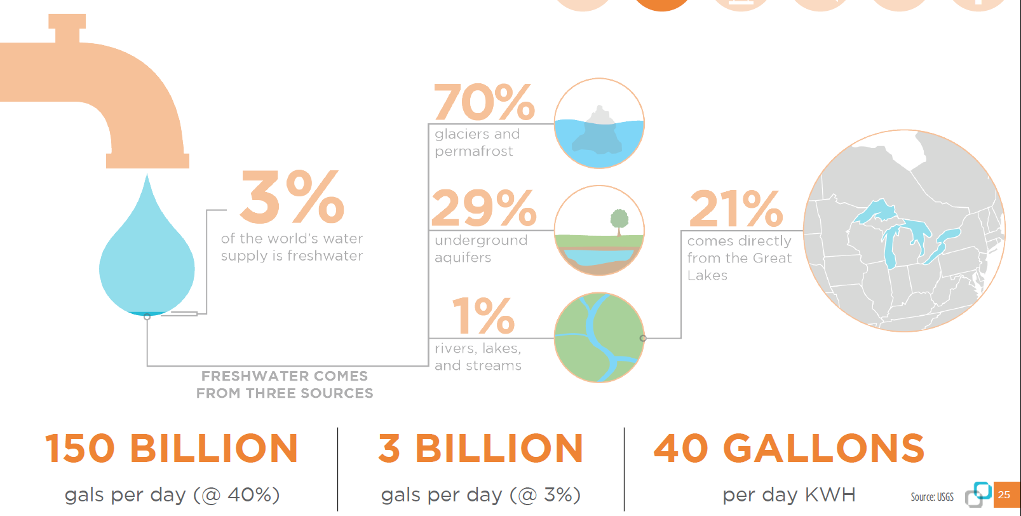
Notes:
The U.S. uses about 350 billion gallons of water per day. The utility industry accounts for about 40% of that, or 150 billion gallons per day.
The U.S. consumes about 100 billion gallons of water per day. The utility industry accounts for about 3% of that, or 3 billion gallons per day.
Key difference is use versus consume.
Water will continue to be a closely watched and valuable resource. We are fortunate to live in the Great Lakes region.

Slide 18
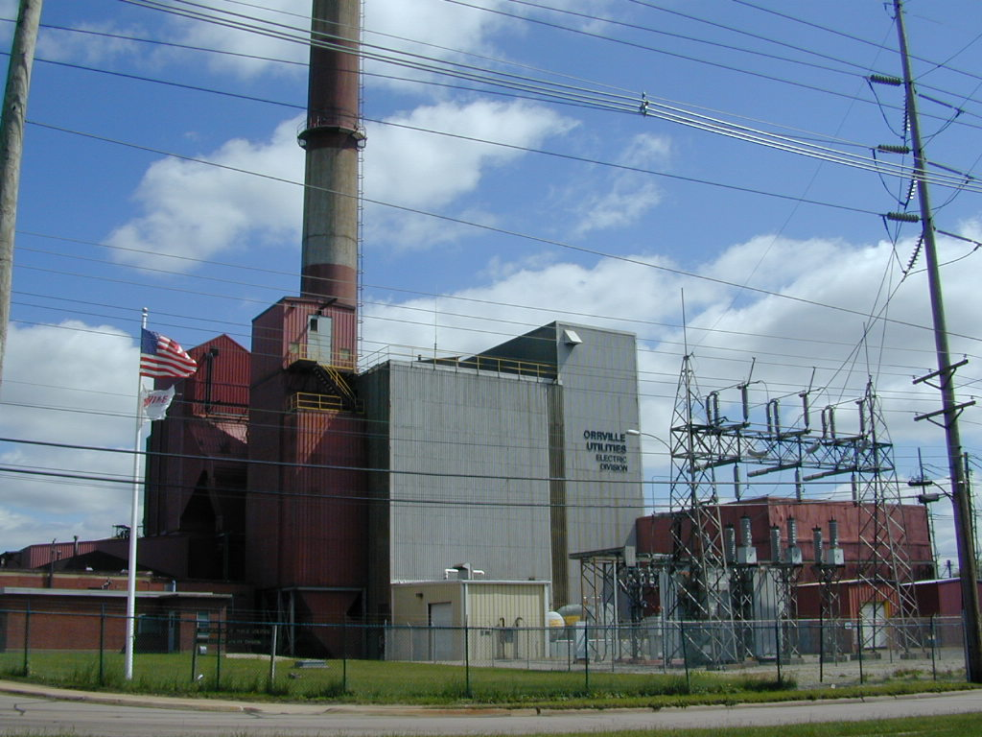
Notes:
Electric Utility
Celebrated 100 years of service. Approx. 650 people visited us during the open house in September.

Slide 19
Orrville Generating Plant
Established 1917
Four coal-fired steam generators providing steam to 3 turbine-generators. Total capacity, 63,000kW.
Last unit installed in 1969
Coal units are now restricted to 10% capacity. Unlimited operation on gas converted unit.
7,385 customers
Operating Budget, $35M (Capital projects, $1.8M)
Burned 18,000 tons coal & 665,000MCF gas to generate ~21% of energy needs
Notes:
Orrville is only 1 of 3 communities (Dover, Painesville is peaking only) in Ohio that generate their own electricity (at one time there were around 100). Others shut down due to age, economies of scale, cost & regulations.
We also own our distribution system (poles & wires) and 8 mile transmission line to an AEP substation were we’re connected to the national electric grid.
Power Plant net generating capacity ~58MW. Three steam-turbine generator units (one 22MW and two 25MW). Unit 9 (22MW) installed in1963, Units 10 & 11 (25MW each) installed in 1969 (these are the original units from Dept. of Defense’s Oak Ridge, TN plant which was part of the Manhattan Project, the atomic bomb development program, originally installed in 1941.
The oldest boiler (steam generator) was installed in 1951 (Boiler10), 1957 (Boiler 11), 1963 (Boiler 12), 1969 (Boiler 13).
Coal cost $1.4M, gas $2.5M ($6.5M for 108,000 tons & $300k for 207,000MCF gas in 2016).

Slide 20
Electric Department
Dean Kallenborn, Electric Utility Manager
Dick Smith, Distribution Superintendent
Sold 301,439,000kWhs in retail sales (up 1%, plant generated about 21%, ~57% lower than 2016)
Peak demand, 58,900KW, July 19th , 2PM
Retail sales, $30.4M
Wholesale sales, $2.3M
298 pole miles of distribution lines covering 125 sq. miles
19 Power Plant employees, 12 Distribution, 4 staff
Notes:
Service area covers the eastern 1/3+ of Wayne Co. Some customers in Stark Co.
Dean has been with us 32 yrs. Dick has been with us 36 yrs.
Normal peak period is in late August/early Sept but we have been close the past few winters. All time peak July 2012, 60.9MW.
Generation lower due to new EPA limits on coal units, new emission limits & higher cost of operation on natural gas converted unit.
Purchase power costs up due to last hydro project coming on line & higher transmissions costs.
Plant personnel down 30% (operations, maintenance & 1 staff) since 2015.
We are in the process of renewing our operating permit (a 6-9 month process). Permit lasts for 5 years.

Slide 21
ACV, Gradall, Orr Products,
Morton Int'l plant closings-2002
Notes:
Retail sales are closely tied to industrial usage. They use approx. 50% of all energy sold.
Grey periods indicate recession periods. Note declines in sales leading up to & during most of the time period.
Major investments in the plant were made in 1986-87 based on our growth rate including participation in our 1st AMP generation project in 1988 (Gorsuch project).
Early 2000 was a tough period due to plant closings and further focused our efforts in economic development (Orrville Office of Industrial Development created in 1996).
We have seen a decline in Residential usage over the past 3 years. Attributing this to energy efficient appliances and CFL/LED light bulbs. Industrial was up mainly from QC.
From Retail Sales History 1964-YTD report.

Slide 22
Notes:
Typical breakout based on customer usage.
Approximately 20% of our customer sales are located outside City limits. 88% of customers are residential, 0.2% are industrial.
Top Industrial Customers are:
Quality Castings (46% or ~2x JMS Co), JM Smucker (28% or ~2x Smith Dairy), Smith Dairy, Bekaert, JLG, Orrvilon, Willburt, Aultman-Dunlap Hosp, Buehlers, Wayne College, Scott’s (see next slide).
From Industrial Customer Usage report.

Slide 23
Top Industrial Electric Customers
Notes:
More detailed break-down of top industrial customers. Similar to 2015 & 2016. Top industrial customers by electrical usage, in kWh’s. We sell ~300,000,000kWh’s annually.
JLG closure impact/revenue loss- $650k electric, $40k W&WW.
We sell the Village of Marshallville energy at the industrial rate. Their usage will be about 15% lower in 2018 due to 700kW solar installation in 3Q 2017.
From Industrial Customer Usage report.

Slide 24
Future of Power Plant
Continued optimism based on easing of regulations
Value increases each year by off setting huge transmission and capacity charges ($4.5M in 2017, $5.5M+ in 2018)
Capable of providing 100% needs during emergencies (will take 8-12 hours if plant is off-line)
Notes:
Gas is still more expensive which means we are going to need to continue to reduce our costs further to remain competitive.
System reliability at more risk until second transmission interconnection is built (3+ years away) since plant is not in service 24/7.
The transmission related outage on April 2, 2018 due to a problem at one of AEP’s substations is an example of a new risk we have not been exposed to since we always had generation on line. 24/7.

Slide 25
Plant Capacity Factor & Retail Sales, 2017
Notes:
Blue line=Retail sales, Red Bars=Plant Capacity Factor (% of time in service each month).
Generated 57% less MWh’s than in 2016.
Capacity factor based on 58MW net. The Power Plant used to operate at 90% capacity factor annually up to January 2017. Will be closer to 14% in 2018 due to new EPA limits forcing operational changes.
From AMP Invoice Summary report.

Slide 26
Notes:
Delete for City Council presentation.
Load growth estimate is conservative. We saw 0.5% increase from 2016 (2% decrease in 2016 from 2015, 0.3% increase in 2016 from 2015).
AMP chart (AFEC=Fremont gas plant, Muni Coal=Orrville Power Plant coal & gas generation). We will show more details on the AMP generation projects later on.
Load vs. Resource projection thru 2037. Our long term power supply study including load growth projections are re-evaluated annually.
Right now, being short (red diagonal striped portion) is not a bad place to be for the short term based on the market.
Note: Power Plant generation (black/white squares) shown as ending in 2030 is for illustration purposes only.
Source: AMP

Slide 27
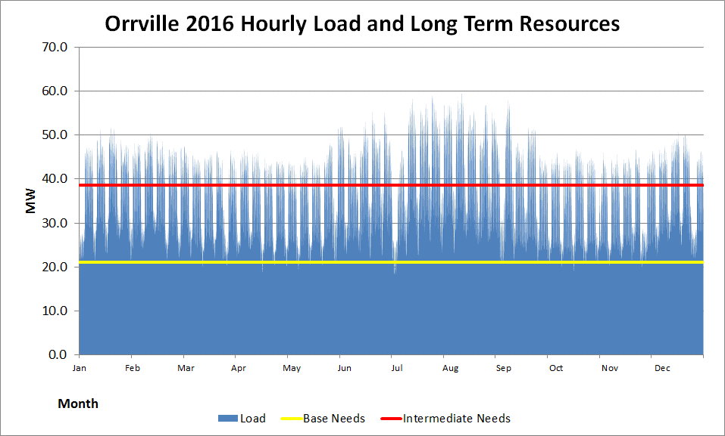
2017 Hourly Load
Peaking 21.2 MW Total Needs
Existing Int. 17.62 MW of 17.6 MW Needs
Existing Base 13.2 MW of 21 MW Needs
Notes:
Base: power is needed all the time, 24/7
Intermediate: additional power needed during higher usages times (M-F and summer & winter periods)
Peaking: maximum usage (extreme temperatures & emergencies)
Power Plant is now a peaking resource (Base prior to 2017).
We are short on base load needs, 6-8MW, and are working to secure this.

Slide 28
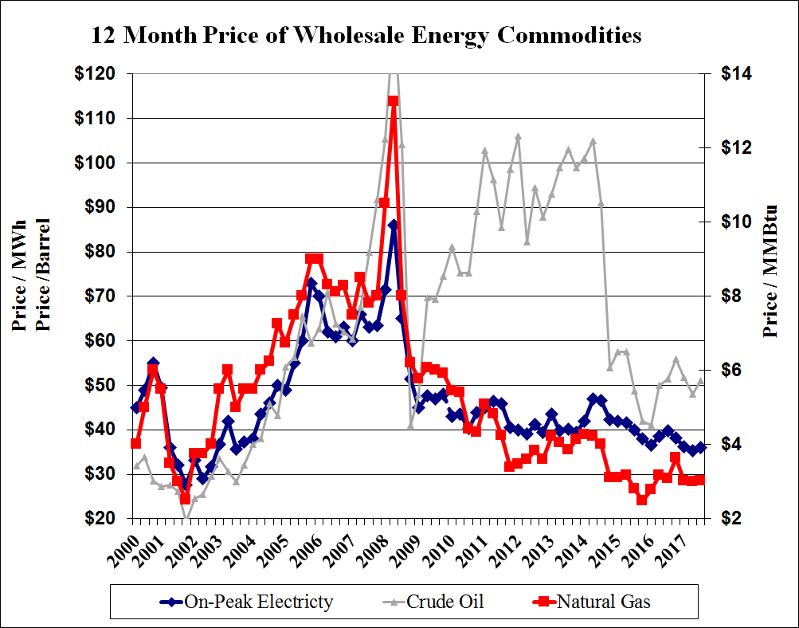
Recession
Began eval. & investment in new generation projects
Notes:
We began exploring and making investments in alternative, long term power supply options to hedge rapidly escalating energy costs in the early 2000 time period. The 18 month recession in 2008-09, shale gas development and coal plant shut-downs replaced by new gas generation changed the energy market in a profound way.
Wholesale market has fundamentally shifted the way we operate the plant since 2009. The past three years, we dropped backed to one unit (2 during winter & summer periods). In 2017, the new EPA regulations went into effect, limiting operation on the coal units to 10% and converting the largest coal unit to natural gas.
How long this cycle continues is up to the economy, global influences, energy policy & cost of natural gas. Our coal costs $2.52/MMBtu. Gas ranged from $2.30-3.80/MMBtu.
Source: AMP

Slide 29
Notes:
Here’s the past 5 years. Power Plant is Blue (50/50 coal & gas in 2018). Total renewables are 21.5% in 2018!
From Generation Portfolio report.

Slide 30
Transmission Credits
generated by Power Plant = $4,579,000
Notes:
Our biggest expense, ~55% of our total costs to operate the utility. Rapidly increasing transmission cost are a concern. It was one of two top issues discussed with our legislators in Washington earlier this year.
These were $1M in 2010 (~$250k in 2006 when the transmission system was turned over to a single operator). The next slide shows this issue in more detail.

Slide 31
Transmission Fees & Credits
Projected
Notes:
AEP is the transmission owner. PJM is the transmission or grid operator (in multiple states) in our region. We pay fees to both.
Number in (red) shows the cost our customers have to pick up after credits generated by the Power Plant.
Transmission owners receive fees i.e. full cost recovery plus 10%+ ROE on upgrades and expansion of the grid.
Transmission credits are generated by the Power Plant or other load reduction measures during peak periods.
Everyone can help in this effort. The more we reduce, the more everyone saves.
2018 & forward based on us meeting the top 5 peak demands (5CP’s) during the year. Generator 9 estimated transmission credit is $1.2M, Generator 10 $2.4M, Generator 11 $2.7M.
The difference in 2017 was due to Generator 9’s outage (outage occurred in 2016 but financial impact not realized until following year).
Source: Transmission Fees & Credits 2014-2022 report

Slide 32
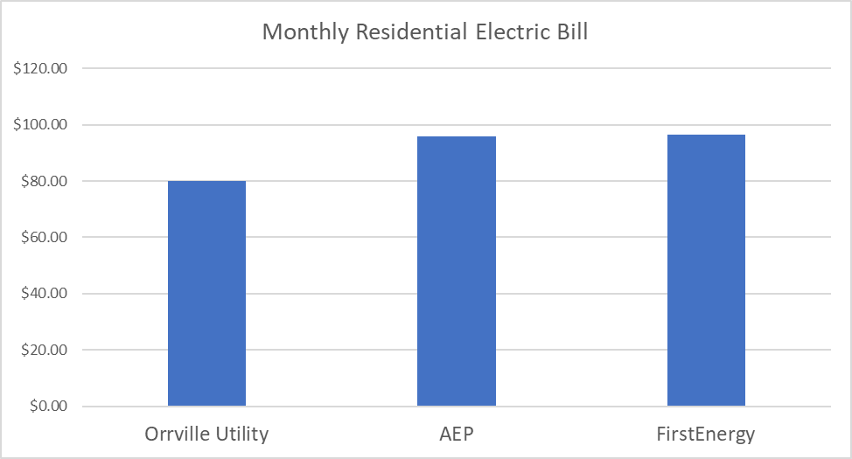
Notes:
The Bottom Line. Most customers do not care where the energy come from. We continue to focus on COST, RELIABILITY & VALUE.
We’re at or above in commercial & industrial rates compared to AEP & FirstEnergy in our area.
Orrville’s rates were fixed the entire year. Orrville 11 cents/kWh, AEP & FE ~13 cents/kWh
Source: 2017 Orrville Rates, customer bills from AEP & FE.

Slide 33
Notes:
APPA member (i.e. Public Power Utilities) range 8.37-37.34 (Hawaii)
Source: APPA Stats and Facts 2017

Slide 34
Energy Sources & Other Costs
Notes:
Delete for City Council presentation.
Orrville Generation (peaking only)- Cost when just operating for transmission system peaks.
Orrville Generation (63MW)- Cost when operating plant beyond transmission peak hours.
Avg. Incremental Cost- Variable cost (mainly fuel) to put addition MW’s out for coal units. Use this to evaluate wholesale market opportunities.
Avg. Incremental Cost, Gas- Variable cost (mainly fuel) to put addition MW’s out on gas unit. Use this to evaluate wholesale market opportunities.
PJM/Pool Incremental See Price- Price we use to determine if we want to make sale into market if entire plant is on line (includes mark-up to make sure we end up in the black on the transaction).

Slide 35
Wholesale Sales vs. Plant Capacity Factor
Notes:
Delete for City Council presentation.
Power Plant was supplying more energy prior to AMP projects which started in 2012. Production costs are declining. Wholesale sales declining which takes away ability to off-set our total cost. We are working on narrowing the gap. 2018 are projected (should be lower). 2014 increase in sales due to polar vortex.
Peak plant capacity factor was 80% in 2008.
From ‘Presentation-Data for Power Plant Reorganization PPT-Revised 4-3-18’

Slide 36
Expected to
be lower
Notes:
Delete for City Council presentation.
2014-2015 the beginning of decline of wholesale market prices & EPA regulation impacts on us.
Expecting Production & Payroll costs to be lower. Figures shown are based on 2018 Final Appropriations. P/R costs for 2016-17 are flat despite lower personnel due to retirement payouts. This will become more apparent in 2018.
From ‘Presentation-Data for Power Plant Reorganization PPT-Revised 4-3-18’

Slide 37
Notes:
Delete for City Council presentation.
Notes: 1986 included for reference. Shift in wholesale sales and purchase power since 2014 (which was a good year due to polar vortex). Purchase power increased in 2012 due to new AMP projects & lower market prices. 2018 wholesale sale projected around $1.5M.
From finance oper data & cost history from 1986 report

Slide 38
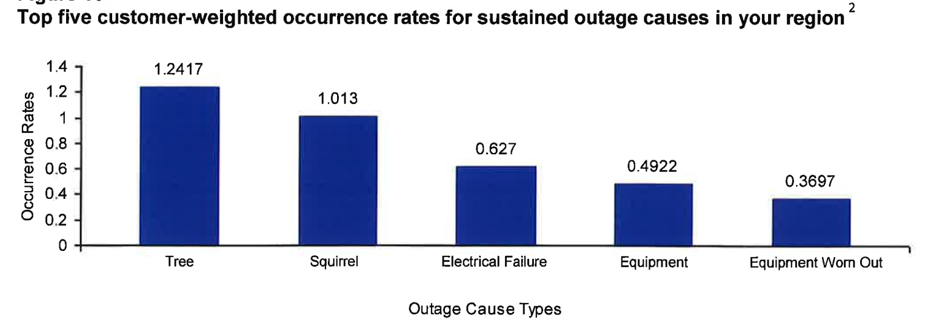
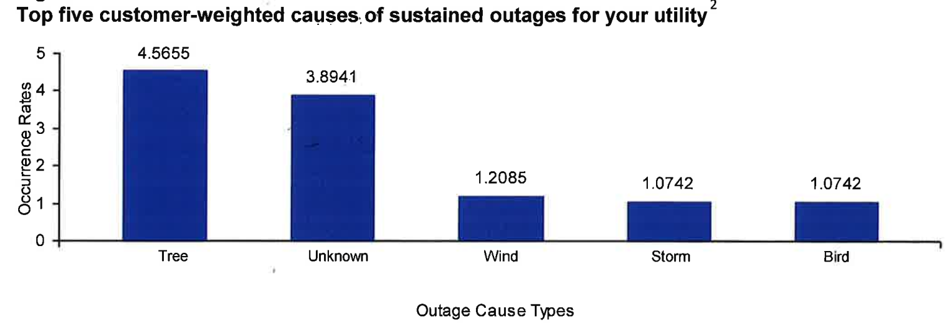
Notes:
Trees caused us more problems this year. We have increase our efforts & expenditures. I believe there are a lot of squirrels in the unknown category.
From APPA Annual Benchmarking Report eReliability Tracker. Despite this, we received national recognition for reliability in 2017.
The next few slides gives a national view on a few topics.

Slide 39
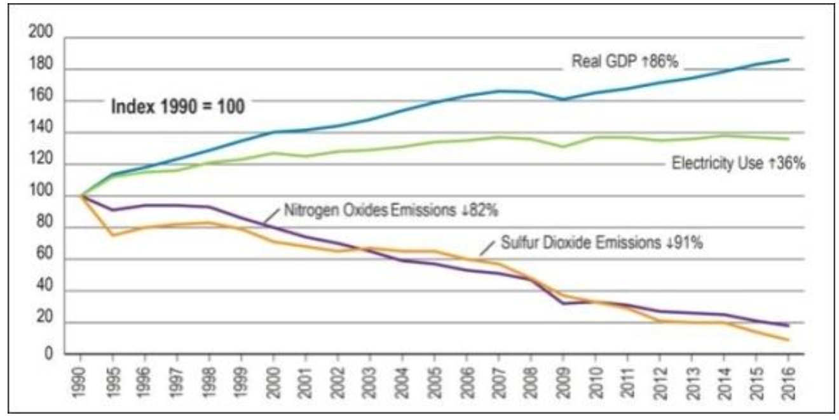
2017 Power Plant Emissions
SO2 decreased 82%
NOx decreased 77%
Particulates decreased 83%
Notes:
This slide shows a lot of progress for the electric industry and us!
Our significant emission reductions were the main driver of EPA settlement. We ended up well below the annual required limits.
SO2=Sulfur dioxides, NOx=Nitrogen oxides, Particulates=Ash, non-combustible particles contained in smoke. Our decreases are mainly due to converting the largest unit to natural gas & limiting the operations of the coal units to 10%.
Very telling national stat’s. Energy usage up 36% while still making huge strides in reductions.
The next chart will show you how it was done.
From Valuing the national investment in coal-based power generation plant air emissions controls report by APPA,EEI,NRECA 2018 report. Plant emissions from EPA FER report.

Slide 40
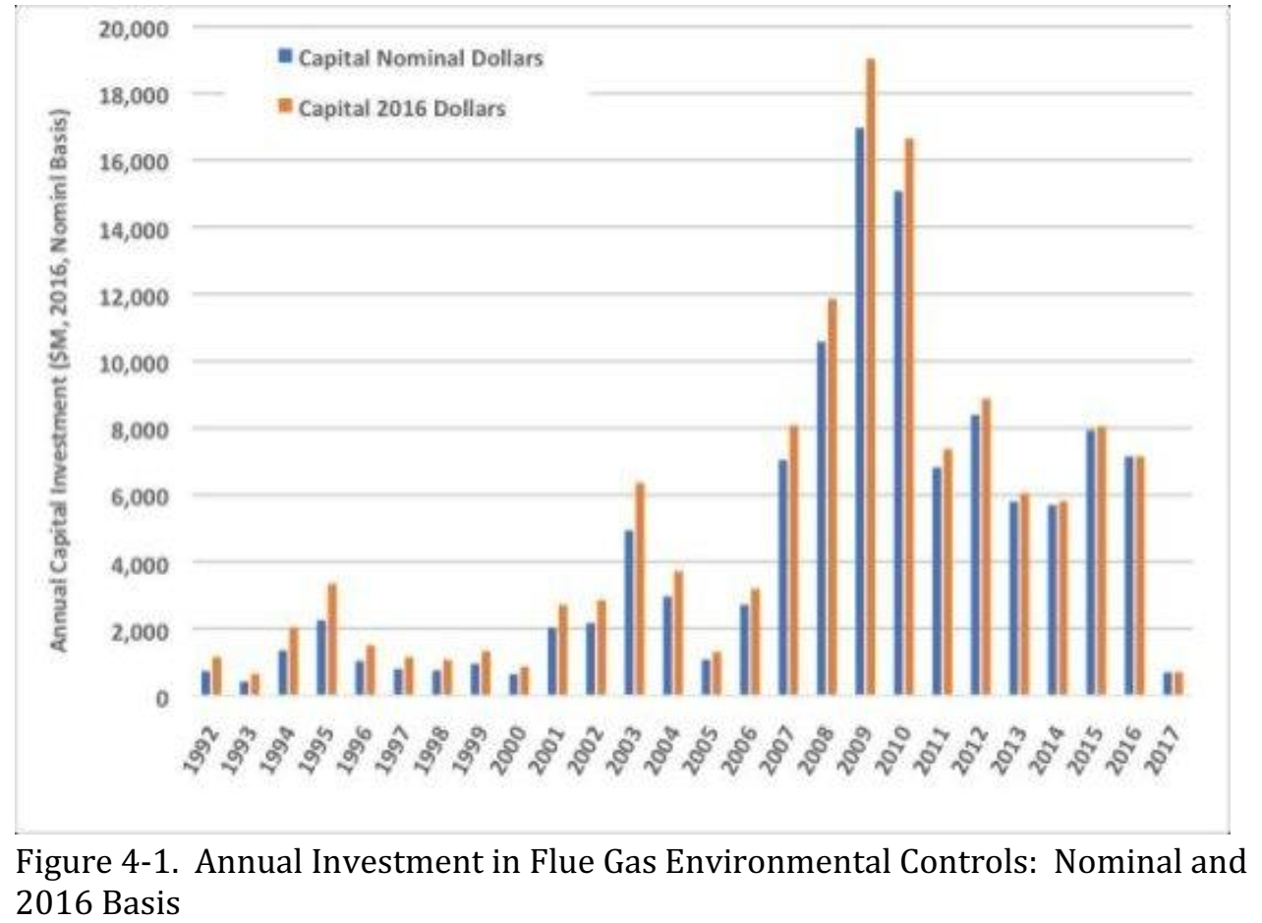
Notes:
With your money. Scale on the left side is in MILLIONS.
Annual investment in environmental controls.
I don’t have to remind you who was in the White House from 2009-2016. About $60B was spent during this time.
From ‘Valuing the national investment in coal-based power generation plant air emissions controls report by APPA,EEI,NRECA, 2018’ report.

Slide 41
Notes:
US generation sources. Most additions in 2017 were gas 49%, wind 29%, solar 20%. Coal decreased as expected.
From 2018 America’s Electric Generation capacity 2018 Update report.

Slide 42
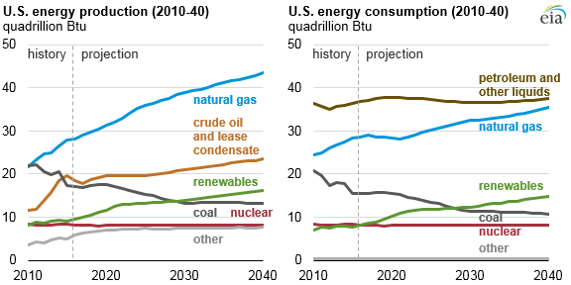
Notes:
US consumption. Coal will still be around for a while but about half what it was in 2010.
Source: U.S. Energy Information Administration, Annual Energy Outlook 2016 Reference case

Slide 43
Power Supply Sources
NYPA (hydro)
Hydro Phase I & II
Prairie St. (advanced clean coal)
Fremont (natural gas)
Blue Creek Wind
Solar
Wholesale Energy Markets
Notes:
These projects & market purchases allow us to diversify to lower our risk exposure due to environmental & regulatory uncertainty, energy market & fuel volatility as well as positioning ourselves for future challenges at the power plant.
We received about 61% of our energy from the projects in 2017 (the balance came from market purchases 24.1% and the power plant 14.6%).
NYPA ( a federal allocation from the New York Power Agency) 8,200MWh’s (94% LF and about 1.5% of our total energy) in 2017. We receive a little less than 1MW from this federally allocated project. It’s the least expense of all of our energy sources.

Slide 44
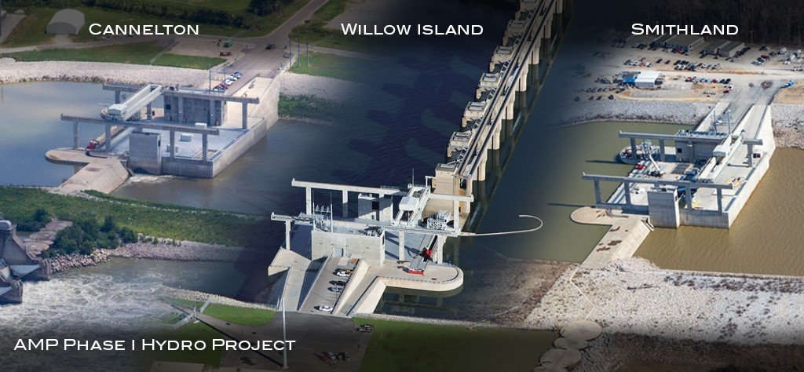
Hydro projects
Notes:
Let’s start with the hydro projects.
These were the largest undertaking of hydro development in the US for decades, 4 plants, 350MW, $3.5B project.
Only 3% of the ~84,000 existing dams in the US produce electricity.
These are views of the Phase I hydro project owned by AMP members developed along the Ohio River on existing locks & dams.
Orrville has 11.7MW. Phase I, 79 participants, Phase II, 48 participants.
These projects took 4-5 years to construct and be around for over 80+ years.
High costs in the beginning (due to high capital), low cost energy after debt is retired in 2045 and 2049.
Each site excavated 2.5-4M cubic yards of material at a cost of $40-70M and used over 90,000 cubic yards of concrete for the power house.
Cannelton 88MW, Orrville 2.49MW (Phase I)
Smithland 76MW, Orrville 2.15MW (Phase I)
Willow Island 44MW, Orrville 1.25MW (Phase I)
Meldahl 112MW, Orrville 3.46MW (Phase II)
Greenup 70MW, Orrville 2.25MW (Phase II)
Received 12.3% of our energy from these projects in 2017.

Slide 45
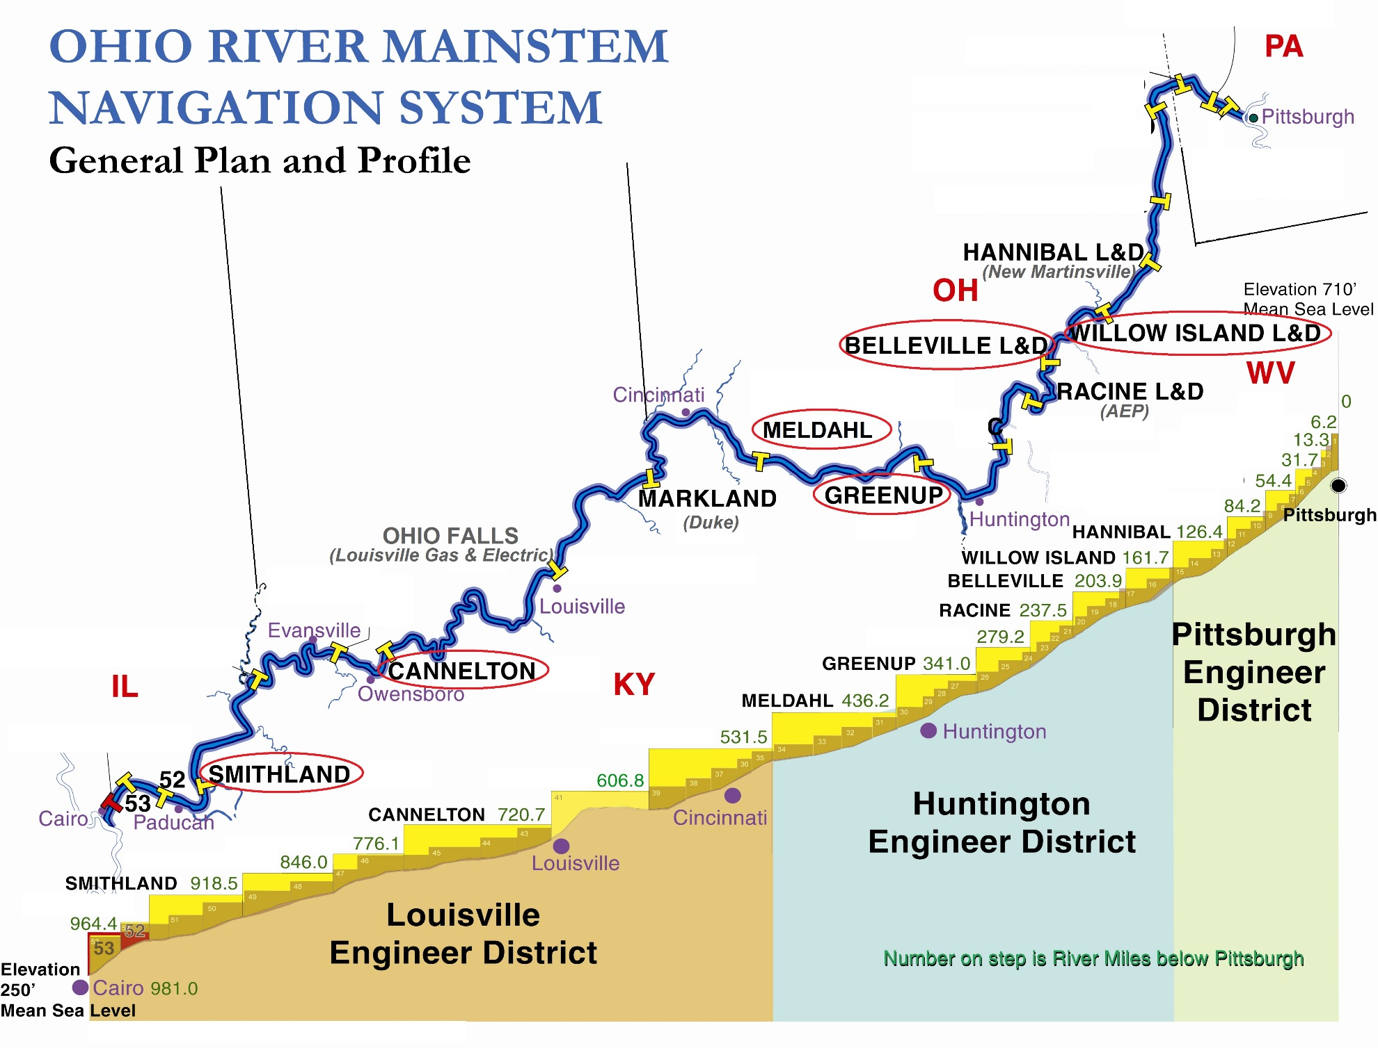
Notes:
Location of hydro’s are on existing lock & dam systems (operated by the Army Corp. of Engineers) on the Ohio River.
We do not have involvement in the Belleville hydro project (other AMP members do however).
The change in river elevation provides the ‘power or head’ to turn the water turbines. The greater the elevation change, the greater the output.
Three other hydro’s are located on the Ohio River. New Martinsville (Hannibal hydro) is an AMP member.

Slide 46
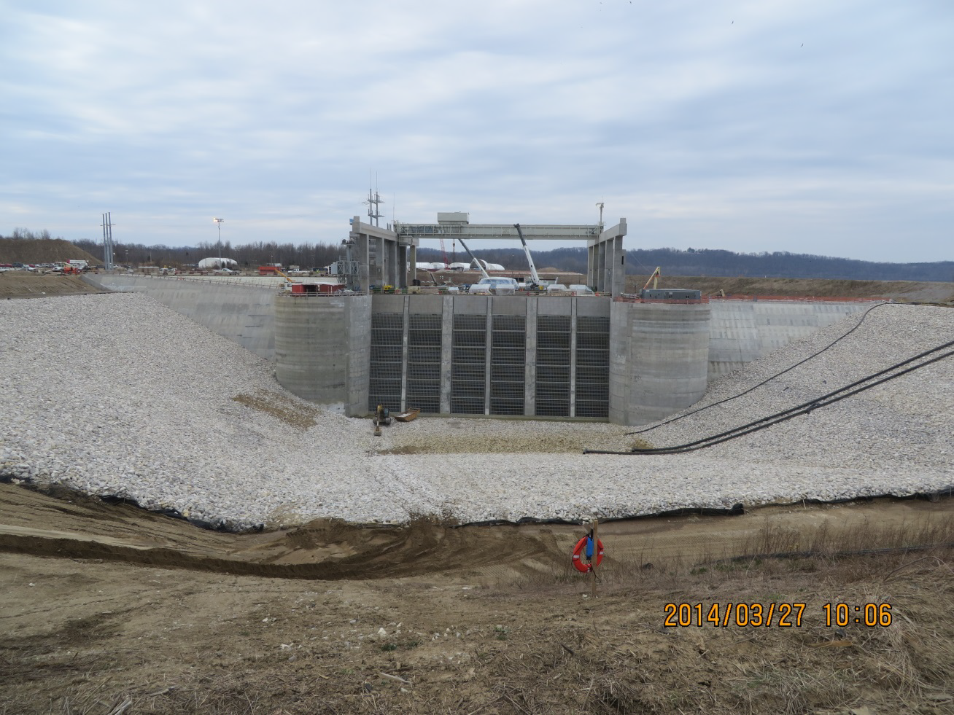
Normal river level
Notes:
Cannelton inlet view before water-up (March 2014).
Most of the plant is under water when in service. Plant is designed to be submerged. In February 2018, Smithland hydro was overtopped 12’.

Slide 47
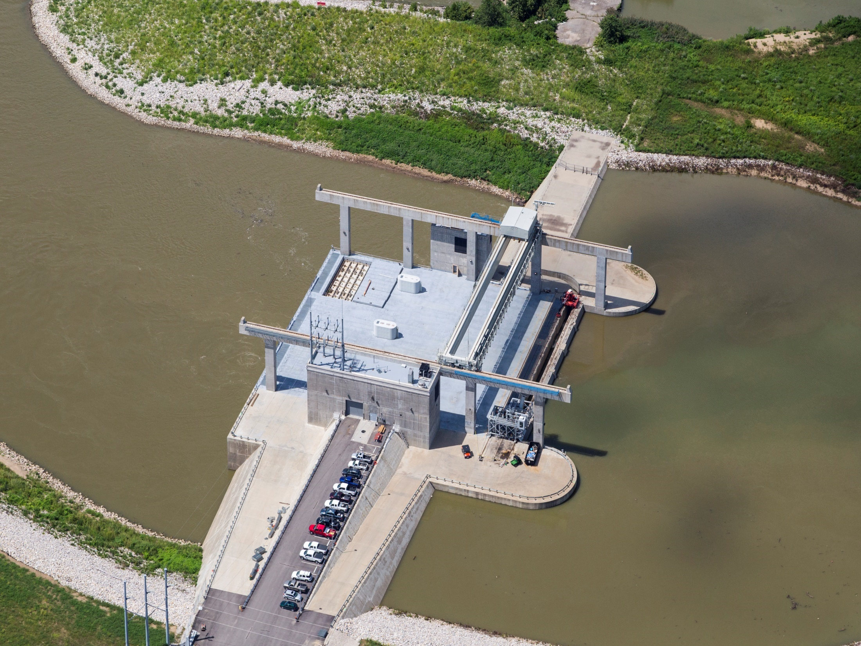
Notes:
Cannelton hydro.
Unit 3 commercial operation 1/27/16, Unit 2 commercial operation 3/22/16. Unit 1 in service 6/16/16. Orrville owns 2.49MW of the 88MW plant.
Typical river operating water levels (~56’ difference). We coordinate with the Corps of Engineers to maximize river pool levels and debris flushing.

Slide 48
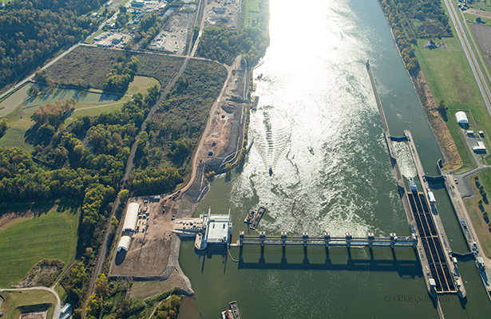
Notes:
Willow Island April 2016.
Commercial operation Unit 1 on 1/14/16, Unit 2 on 2/2/16. Orrville owns 1.25MW of the 44MW plant.
Lock is on right with coal barges, dam in middle, hydro plant on left side.

Slide 49
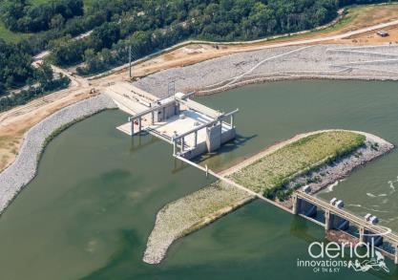
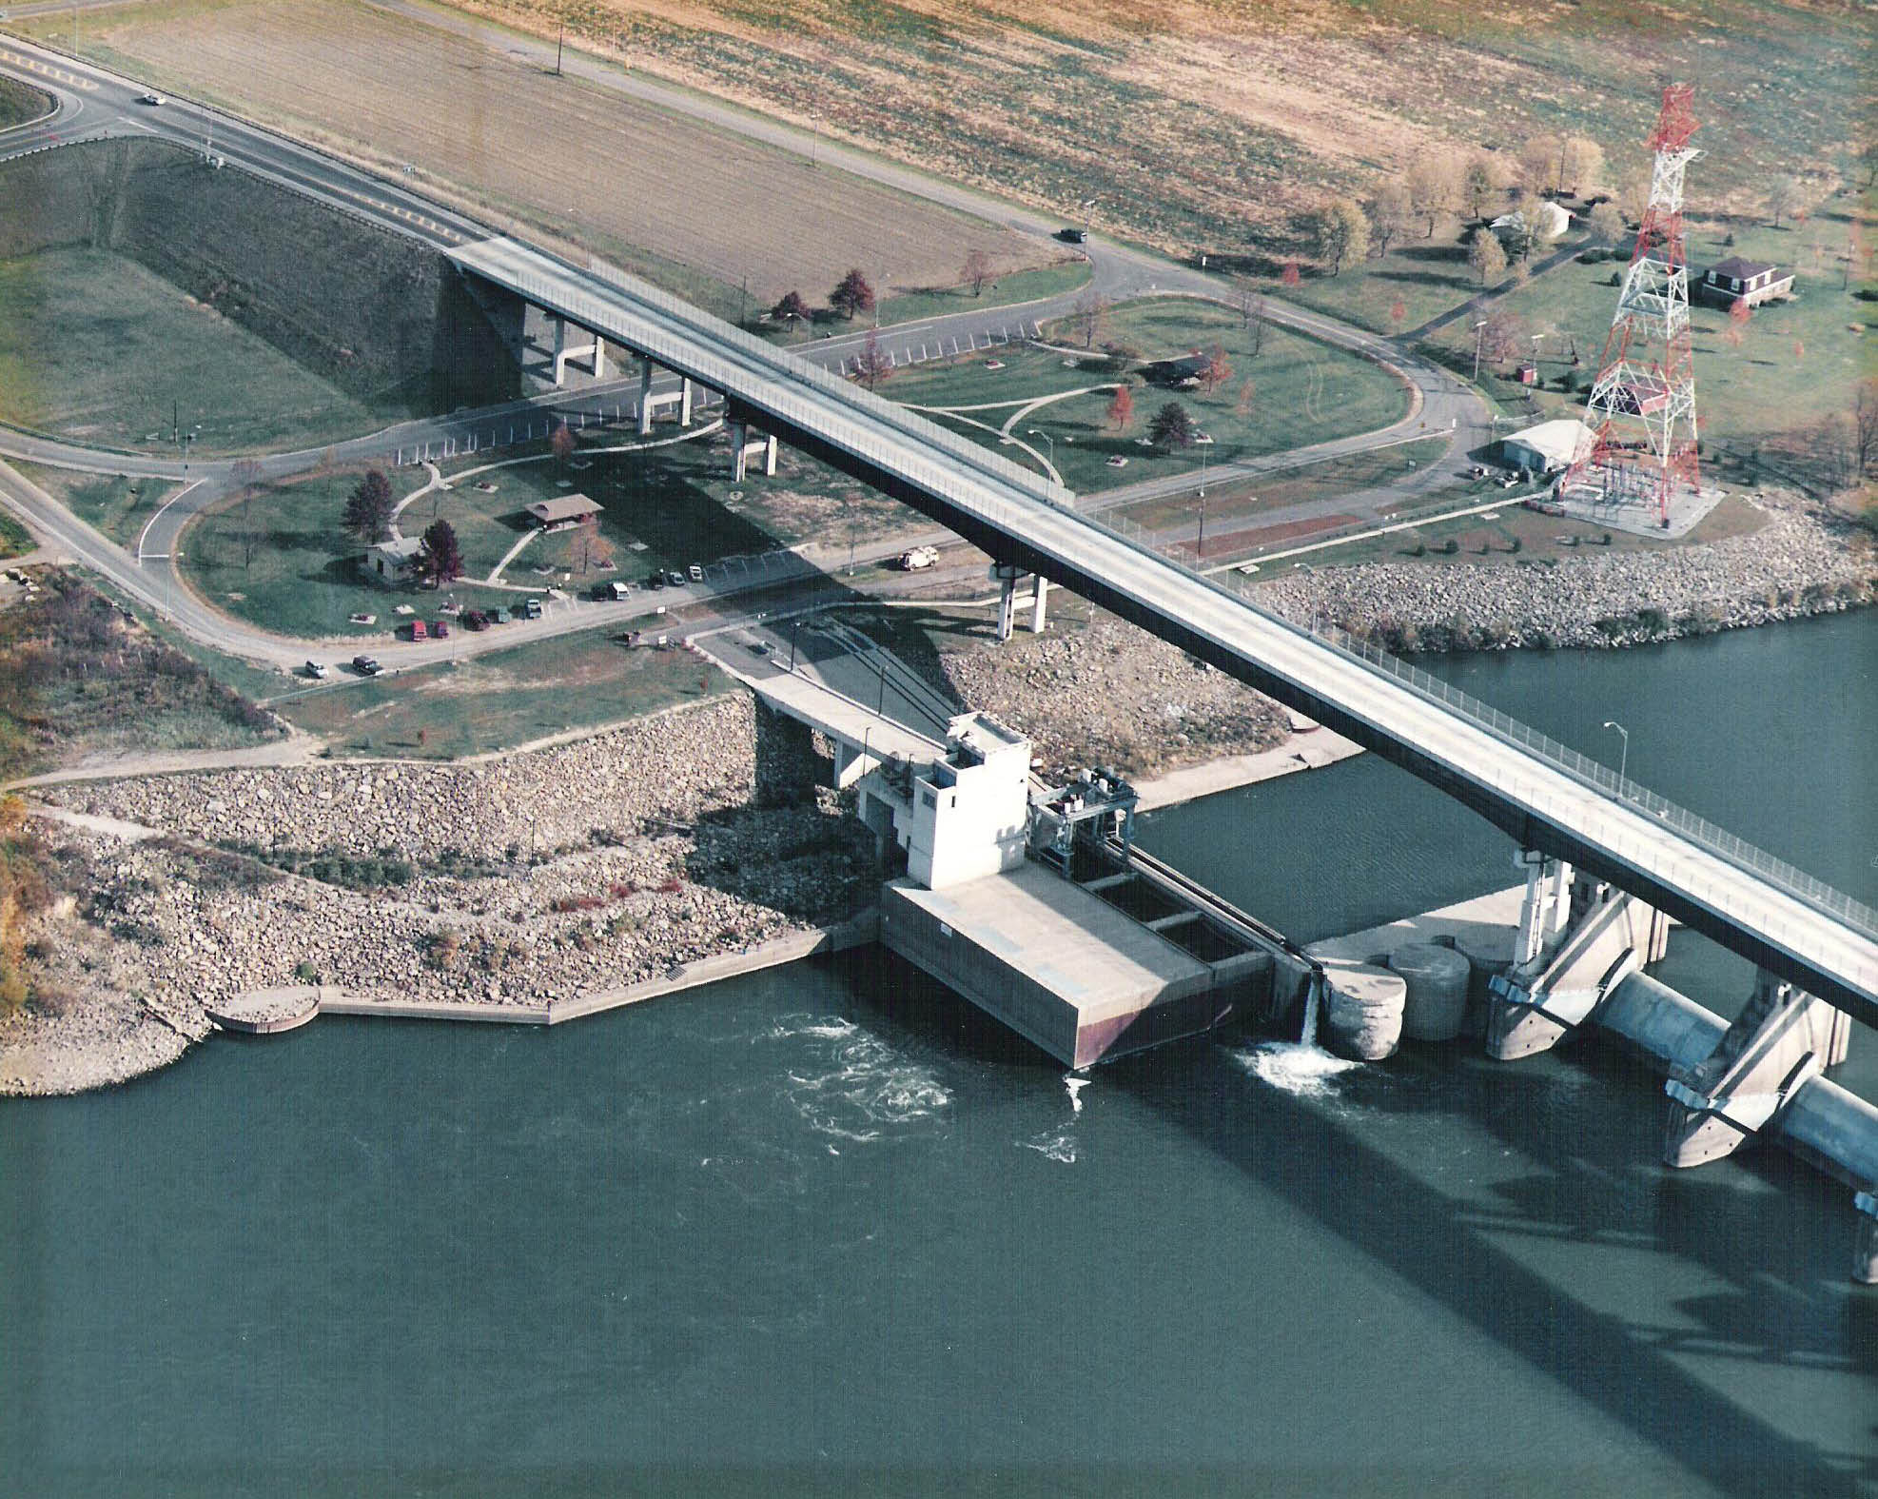
Meldahl Hydro
Greenup Hydro
Notes:
Meldahl site today (Phase II), top left. On Kentucky side of river. Plant in full commercial operation April 12th 2016 (Unit1 2/14/16, Unit 2 1/20/16, Unit 3 4/12/16). Orrville owns 3.5MW of the 105MW plant.
Greenup (Phase II), lower right, was built by the City of Hamilton in 1982 (licensed thru March 2026). Orrville owns 2.3MW of the 70MW plant.
Hamilton owns 51.4%, AMP members 48.6% of both projects.

Slide 50
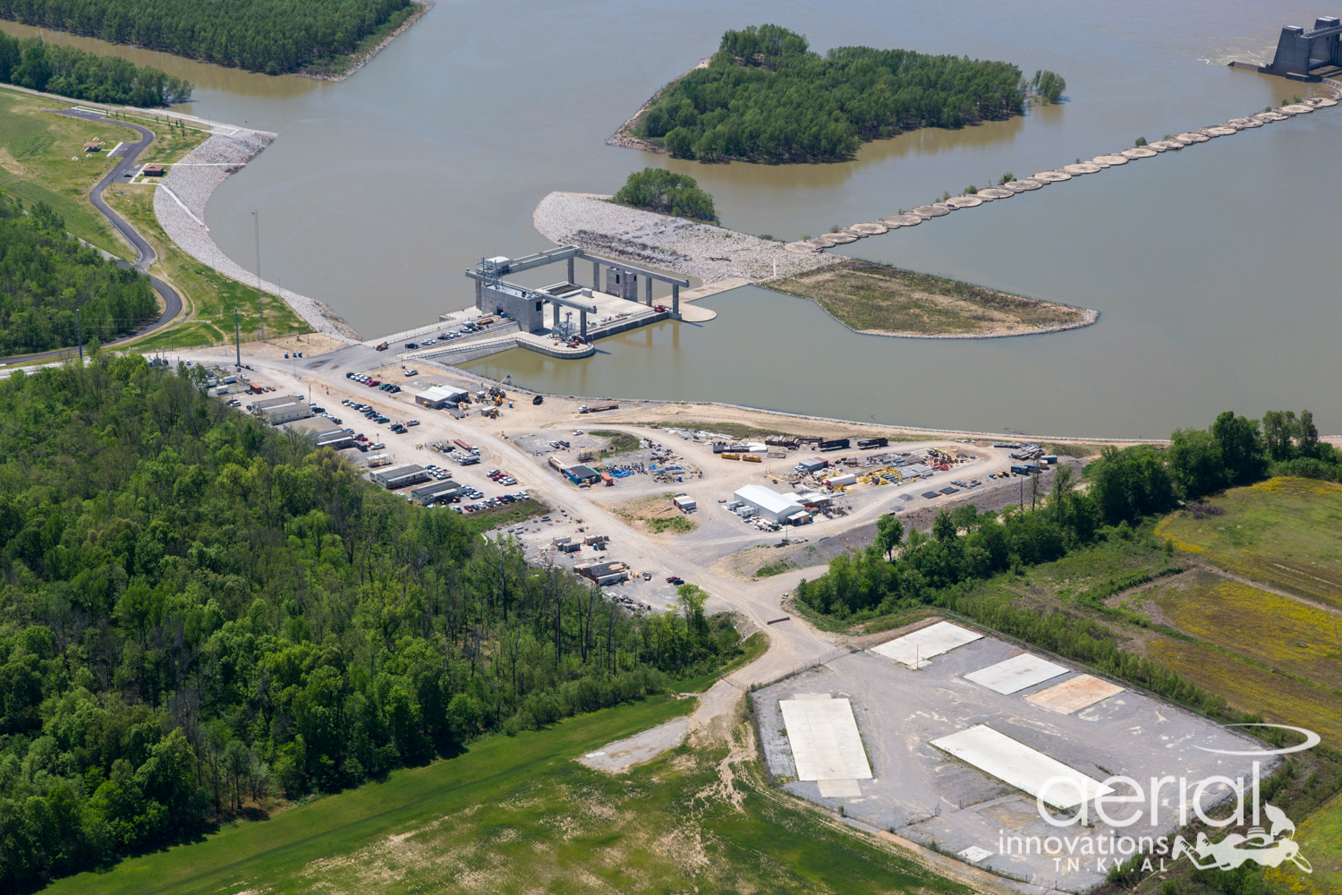
Notes:
Smithland hydro. Last hydro completed in July & August 2017. Orrville owns 2.15MW of the 76MW plant.
Water elevation difference is ~46’.
Located at a wider section of the river. A channel was cut thru the island in the upper left of the picture. The area where the plant is located was excavated out of the river bank.

Slide 51
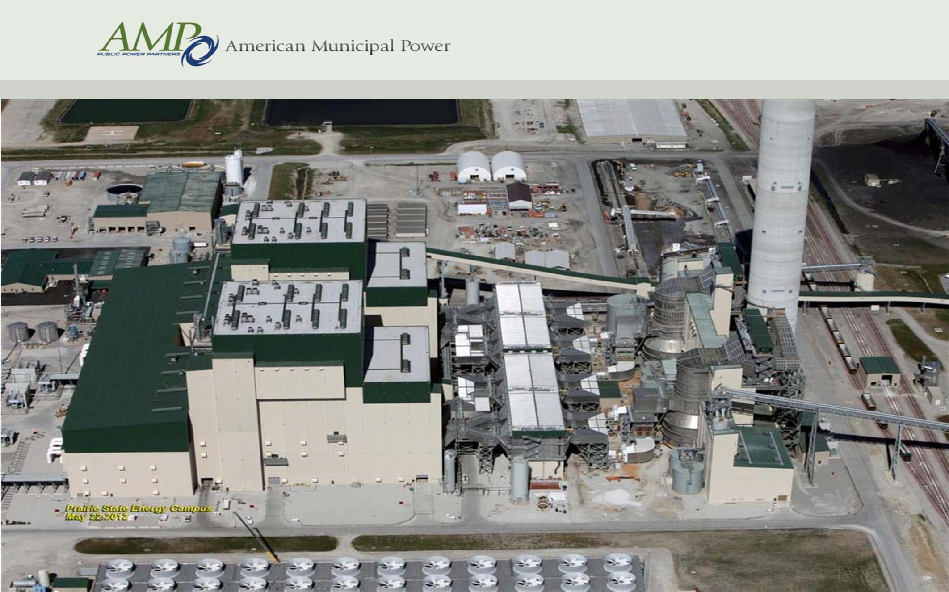
Prairie State project
Boiler House
Generator Bld.
Pollution control equipment
Cooling towers
Notes:
A $4B, 2 unit, 1600MW state-of-the-art coal-fired plant located in Illinois (25+ times bigger than our power plant).
Over $1B in pollution control equipment. We also own 25+ year coal supply (~$1B) underground, next to plant, a huge benefit.
The coal mine is 200’ underground, 7-9’ coal seam. Provides long term stability on fuel pricing. Plant burns in 1 year what would take us 32 years prior to 2017.
Orrville is one of 68 participants owning a 25% majority share of the project. We have 5MW (provided about 11% of our energy needs). This facility was started up in June 2012.
Efficiency and capacity (output) is higher than originally projected.
A great long term project utilizing an abundant fuel source.
Received 42,000MWhs or 12% of our energy (96% LF) from this project in 2017.

Slide 52
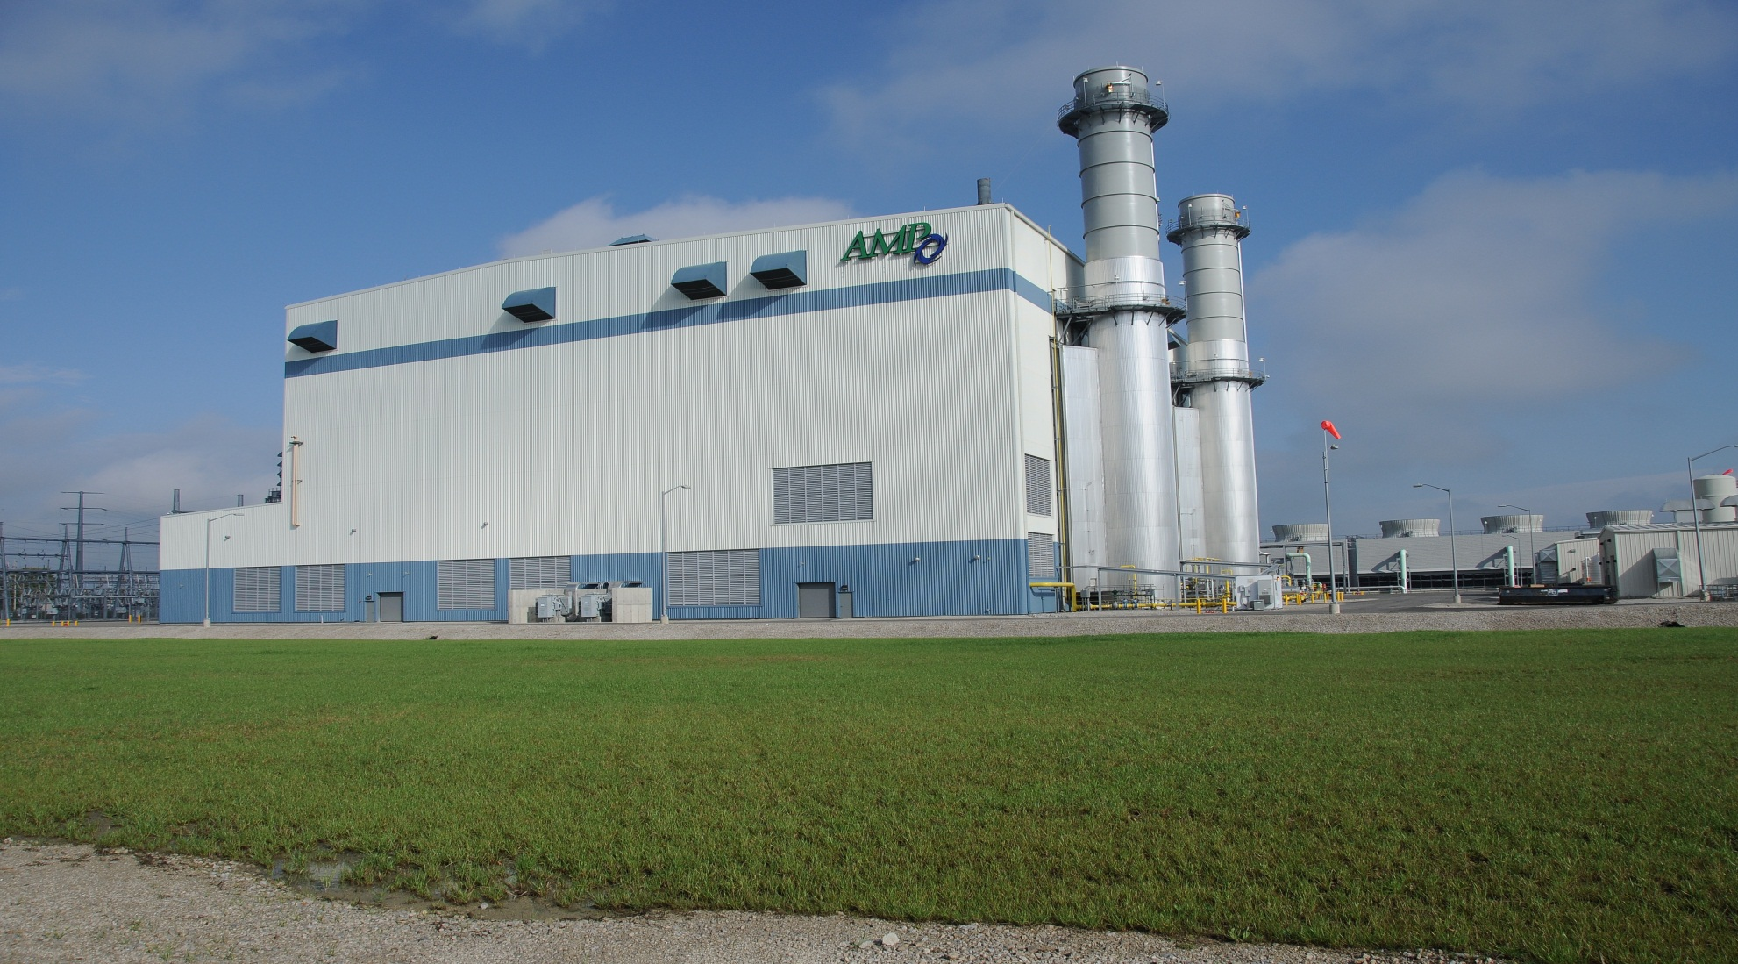
Fremont project
Notes:
A $675M, two unit, 700MW natural gas-fired, combined cycle plant located in Fremont, OH. Orrville has 23.8MW share. Orrville is one of 87 participants.
The plant was started up in January 2012. Natural gas generates half the emissions of a coal plant.
AMP members purchased from FirstEnergy in 2011. Prior to this, the plant was in/out of bankruptcy, until we completed final construction ~10 years after it was first started by Calpine (a merchant builder/owner/operator).
Project continues to exceed expectations.
Received 108,500MWhs or ~30% of our energy (52% Load Factor) from this project in 2017.

Slide 53
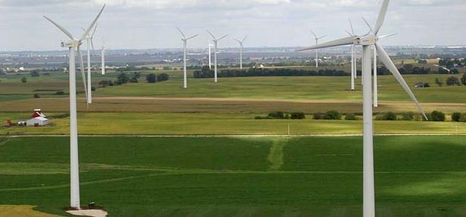
Blue Creek Wind project
Notes:
(152) 2MW Gamesa G90 wind turbines located in Paulding & Van Wert, OH counties (located along SR30, near Ohio/Indiana border). Orrville receives 2MW thru 2022.
We do not own any assets in this project (purchasing energy only via Purchase Power Agreement).
Towers are 328’ tall, blades 110’ long, each unit weighs 85 tons and tracks wind direction & adjusts blade angle to optimize the wind’s energy.
This power supply only contract started delivering energy in June 2012 and was an opportunity for us to purchase energy below actual cost due to weak market prices.
Received 5,400MWhs or 2% of our energy (31% Load Factor) from this project in 2017. If we were relying solely on these, the lights would have been out ~70% of the time.

Slide 54
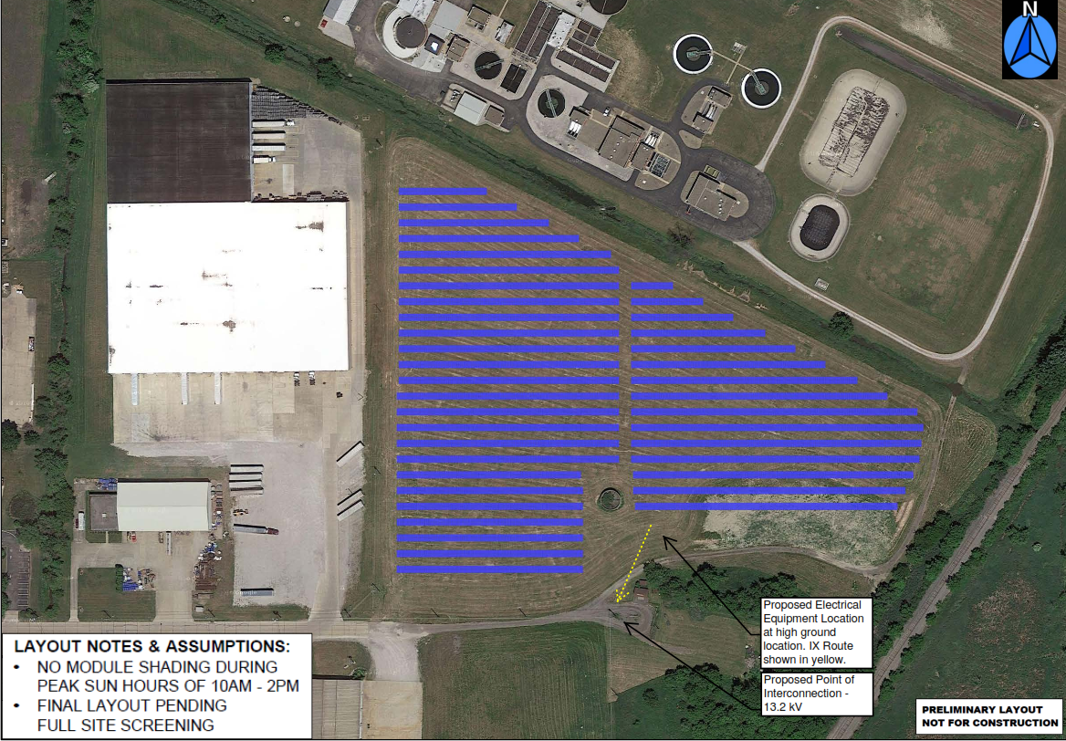
D&S Distributor’s
Warehouse
RTT Route
Railroad
Allen Dr
Notes:
2.25MW site located at end of Allen Dr. 10 acres (~8130 PV modules, ~3600MWh/yr, fixed mounted at 25^{o)}
In commercial operation March 3, 2018. Both sites are fenced in. The concrete tank (in middle) was removed to place additional panels.
The WWTP is to the north. Rails to Trails route (yellow line) will follow the creek and go between warehouse building to exit on Allen Dr. in late 2017 or early 2018.
Will receive about 1% of our energy from both solar projects in 2018.

Slide 55
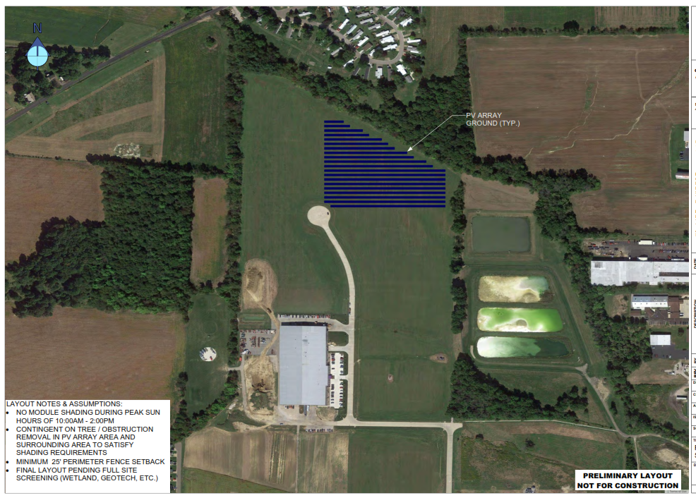
Venture Products
Animal
Supply Co.
Venture
Products
parking
Venture Products
Dairy Lane
Smith Dairy
Orrvilon
Notes:
0.95MW site in new industrial park. 6 acres (~5600 PV modules, original designed for 1.3MW, lower due to wetland avoidance), ~2400MWh/yr, fixed mounting at 25º )
In commercial operation on January 26, 2018. Property is in floodplain & wetlands area and was not suitable for building.
Three Water Dept. lime lagoons on right.

Slide 56
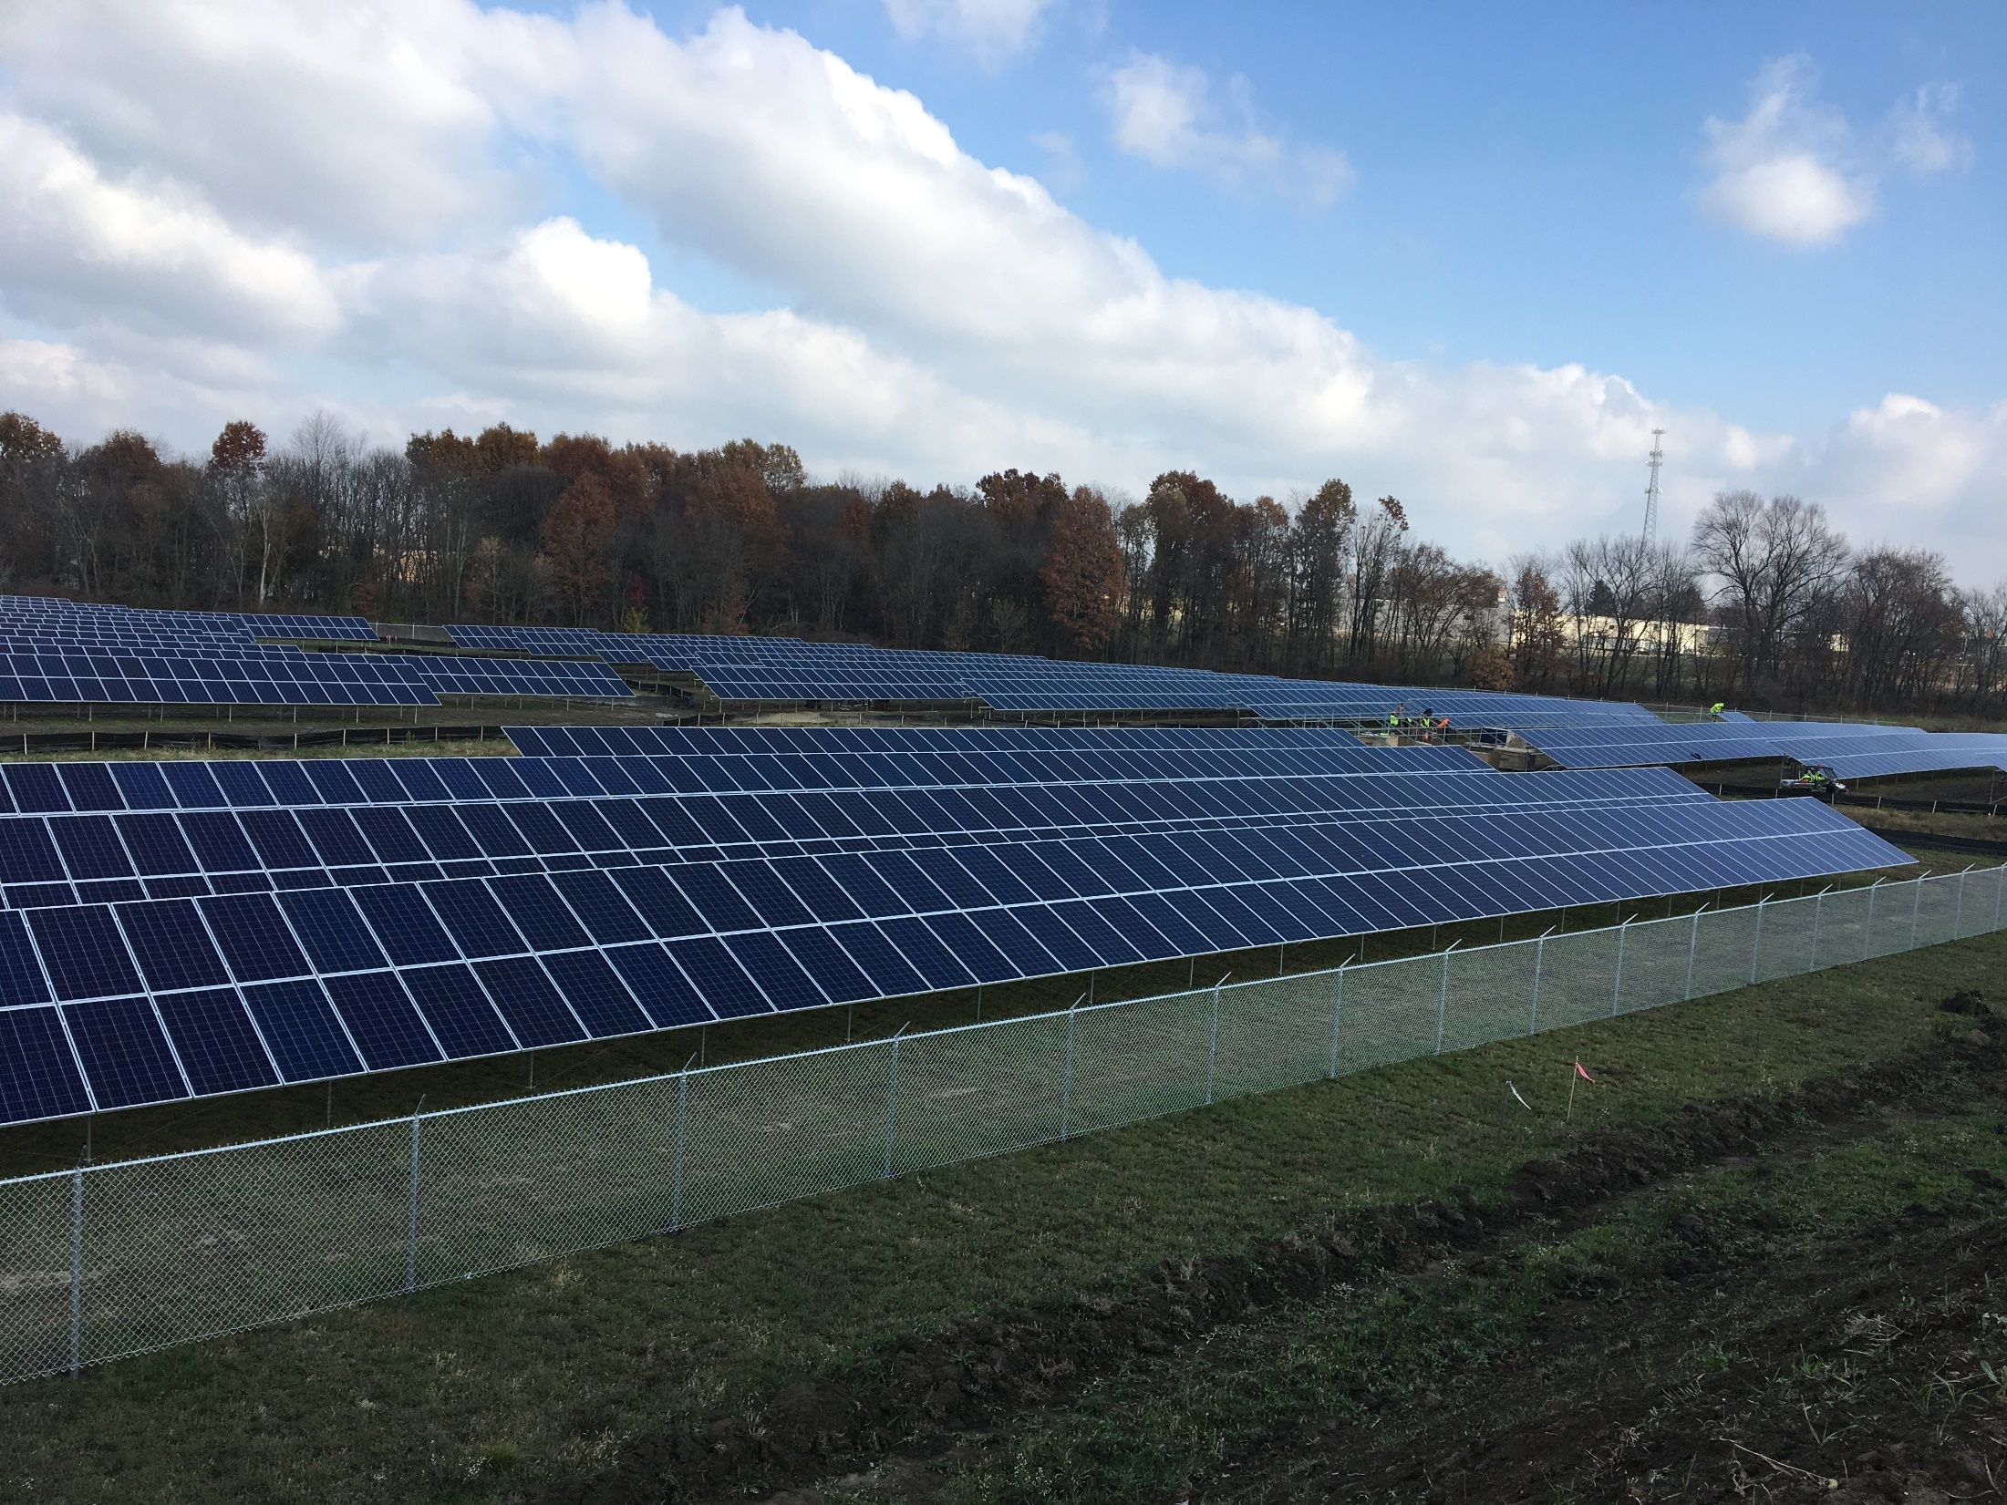
Notes:
This what the site looks like today.
We will have an open house later this year.

Slide 57
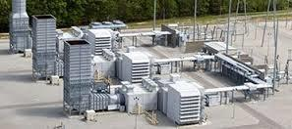
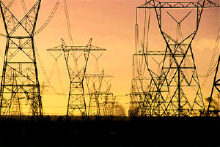
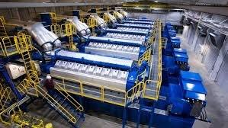

Future Projects?
Notes:
Added long-term wholesale power purchase this year to off-set base load loss (Power Plant).
Some of the other potential projects we’ll be looking at in the future include natural gas combustion turbines (top L), natural gas engines (bottom L), wind (bottom R).
We will always have some portion of our energy coming from the markets since it’s just too expensive and risky to build & own everything. We are also looking into the possibility of owning some transmission (if you can’t beat them, join them).

Slide 58
Utility Financial Overview
ELECTRIC | 2017 | 2016 | 2015
Revenue Fund P/R | 5,890,000 | 5,837,682 | 6,149,627
Other | 28,989,419 | 32,174,175 | 28,593,438
Total | $34,879,419 | $38,011,857 | $34,743,065
Capital Fund P/R | 437,703 | 509,998 | 400,543
Other | 1,339,888 | 1,762,422 | 881,967
Total | $1,777,591 | $2,272,420 | $1,282,510
Debt Service | $0 | $0 | $0
Transfers | $3,324,863 | $6,568,729 | $6,628,857
Grand Total Expenses | $36,745,749 | $40,574,074 | $36,121,087
Grand Total Revenues | $41,915,318 | $42,528,204 | $40,725,304
WATER
Revenue Fund P/R | 1,148,668 | 1,172,336 | 1,079,189
Other | 1,269,346 | 2,597,956 | 2,475,808
Total | $2,418,014 | $3,770,292 | $3,554,997
Capital Fund P/R | 5,465 | 4,306 | 0
Other | 212,511 | 198,503 | 87,981
Total | $217,976 | $202,809 | $87,981
Debt Service | $543,178 | $841,364 | $737,665
Transfers | $36,000 | $572,145 | $909,697
Grand Total Expenses | $2,635,990 | $3,973,101 | $3,642,977
Grand Total Revenues | $3,029,441 | $3,933,738 | $4,198,535
WASTEWATER
Revenue Fund P/R | 1,271,030 | 1,300,287 | 1,205,854
Other | 986,457 | 116,957 | 884,628
Total | $2,257,487 | $1,417,244 | $2,090,482
Capital Fund P/R | 0 | 0 | 0
Other | 280,785 | 310,688 | 901,845
Total | $280,785 | $310,688 | $901,845
Debt Service | $0 | $0 | $0
Transfers | $306,487 | $384,540 | $436,782
Grand Total Expenses | $2,538,271 | $2,938,548 | $3,130,974
Grand Total Revenues | $2,589,001 | $2,820,981 | $2,620,874
TOTAL UTILITIES
Grand Total Expenses | $41,920,010 | $47,485,723 | $42,895,038
Grand Total Revenues | $47,533,760 | $49,282,923 | $47,544,713
Notes:
All utilities are in good financial condition. Please refer to Ms. Strimlan’s annual report for more details (other detailed department spreadsheets are in supplemental slide section). Total payroll down 1%, total spending down 14.5%, total receipts down 4%.
Major funds are shown. Grand Totals include all funds.
The Revenue funds includes plant O&M, Finance & Law departments.
Transfers are used to fund capital and major O&M costs and are a good indicator of the financial ‘health’ of the utility.
The Electric & Wastewater utilities are debt free. We expect the Water utility to be debt free within the next few years.
We carry over at least 3 months worth of operating expenses for unforeseen needs.
More details will be provided in our published annual report.

Slide 59
Upcoming Challenges
Aging workforce/Succession planning
Grid security & reliability
Enhance electric system reliability (2nd tie to grid)
Secure longer term base load energy needs
Financing future infrastructure improvements
Increasing transmission costs
Restoring lost interest costs on Build America Bonds
Development of third Industrial Park
Notes:
ALL key departments heads are eligible to retire.
We will still be coming to the Utility Board & City Council to change job classifications as we re-evaluate duties to deal with shrinking workforces.
Goal to minimize any changes in electric rates in 2018. Expect to start on second transmission connection project this spring.
We deleted EPA regulations for the first time in many, many years due to an easing under President Trump.
Congress continues to look at potential changes in tax exempt financing. This is the main tool local governments use to pay for high cost, long term projects. Hopefully some good will come out of the President’s infrastructure bill. I believe we are in good shape to cover the expenses associated with the second transmission connection.
We have been discussing the rapidly increase in transmission costs ($1M in 2010, $7.5M in 2018) and the $1.8M extra expenses the government promised when we financed the Prairie St and hydro projects. (with the possibility of it increasing to over $30M if not addressed over the life of the bonds).
We only have 1 industrial site left. Funding sources to develop the next park (estimated at $M) is scarce which means we’ll have to get creative.

Slide 60
Economic Development
Mike Hedberg
In 2017, companies invested over $46.5M and added 136 new jobs.
Since 2004, our community has benefited from over $471.5M in investments and created & retained more than 2,400 jobs.
Wayne Co. was named again in top 10 (3rd out of 550) micropolitan areas in the country. The 12th year in a row of being in the top 10.
Notes:
Will end the presentation on a good economic note.
JLG’s closure will have an impact on all of us especially the City’s income tax. We are expecting to hear some good news on the facility soon.
Mike Hedberg does an excellent job working with County and State officials.
This office partners with the City, Chamber of Commerce, The Wayne Economic Development Foundation & the State to promote and enhance business & industry development in our community.
Top Micropolitan Area in America (out of 550 communities under 50k in population).
Will also be working on filling existing sites (only one left), beginning development of 3rd industrial park, workforce & real estate development.
Source: M Hedberg and Chamber of Commerce

Slide 61
Thank You
Visit us at www.orrutilities.com
Questions?
Notes:
Visit our website for more information.
Thank you.

Slide 62
Supplemental slides

Slide 63
Public Utility Board
Board Members
-Michele Abel (Pickett Tax & Investment), President
-Russell Miller (JM Smucker), Vice President
-Don McFarlin (Moog-Flo Tork)
-Brad Strausbaugh (Orrville Schools)
-Paul Vance (Mennonite Mutual Insurance)
Meetings every second & fourth Monday at 6:30PM in City Hall
Notes:
For City Council presentation (insert after slide 1)
Let’s begin will a little background.
The Utility Board, by City Charter, is responsible for operation & maintenance, improvement or expansion and the establishment of rates for the Electric, Water & Wastewater Utilities. Board members are appointed by the Mayor.
The Board appoints the Director of Utilities who manages the Electric, Water & Wastewater Utilities.
All utilities are non-profit and have their own enterprise funds (i.e. rates are set separately to ensure each Utility is independent & financially sound).
There is no formal subsidizing between the Utilities or City. By ordinance, however, the City receives free electric for the buildings & street lighting.
In addition, the Utility operates 65 miles of fiber optic communication systems & provides City-wide computer systems and network support.
All Utilities are relicensed (operating permits renewed) every 3 to 5 years. Generally the EPA imposes additional limits & operating restrictions with each renewal.
We will start with the Waste Water Utility.

Slide 64
Notes:
7,385 electric customers. 7447 total number of meters (city buildings, street lighting circuits, multiple W & WW accounts like wells).
From Brenda’s DOE report.

Slide 65
Notes:
From Brenda’s DOE report.

Slide 66
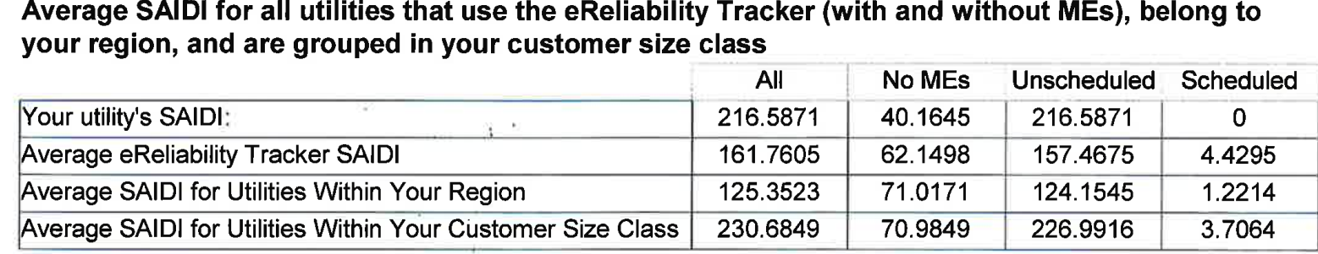
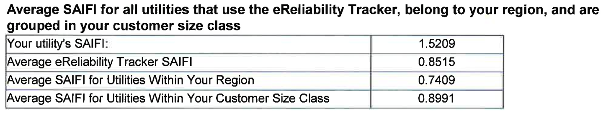
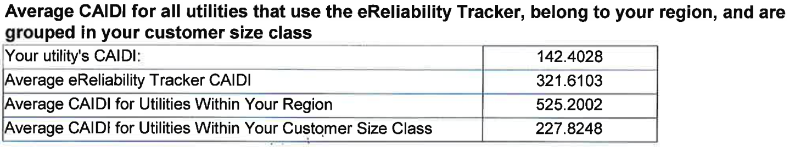
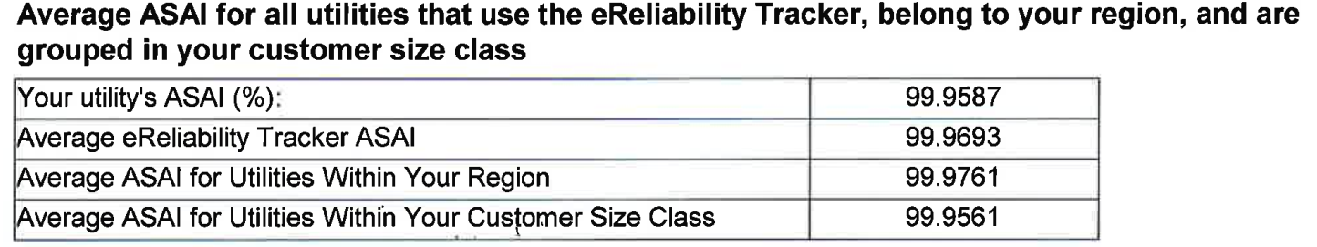
Notes:
For Board presentation. Insert after Outages Causes slide.
These indexes allow us to target areas of improvement.
We were recognized by APPA for achieving exceptional electric reliability in 2017.
SAIDI-average outage duration (minutes) based on effected customers. Higher than our peers due to large number of customers outside City limits.
SAIFI-number of times a customer will experience an interruption
CAIDI-average duration of outage based on total number of customers
ASAI-% of time service was available
From APPA Annual Benchmarking Report eReliability Tracker.

Slide 67
Hydro Project Update
Cannelton, 88MW, 3 Units
  All units in service
Meldahl, 112MW, 3 Units
  All units in service
Willow Island, 44MW, 2 Units
  All units in service
Smithland, 76MW, 3 Units
  All units in service
Greenup 70MW, 2 Units
  AMP Members own 48.6% share of facility
Notes:
Cannelton, Smithland & Willow Island are part of Phase I hydro.
In addition, we have an ownership share in the City of Hamilton’s existing Greenup Hydro facility as part of the Phase II hydro project.
Hamilton built Meldahl and sold 49% to AMP members as part of Phase II hydro project.

Slide 68
Resource Summary
Notes:
AMP project debt service.
Source: AMP

Slide 69
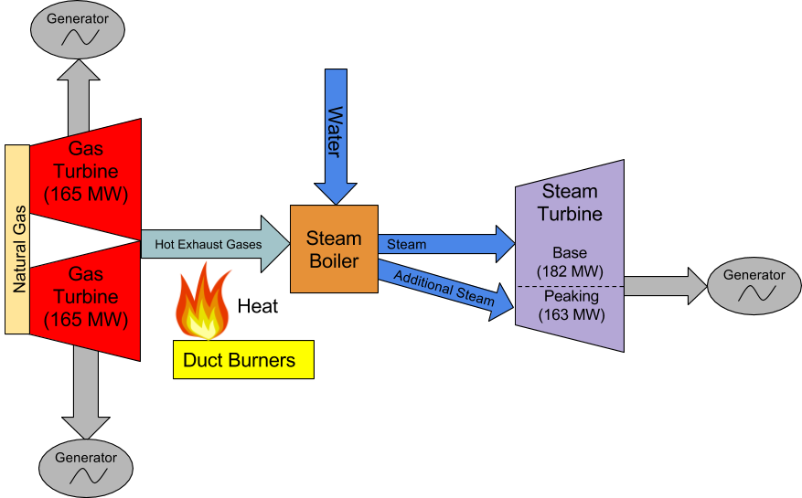
Fremont Energy Center
Notes:
Fremont is a combined-cycle plant (more efficient, higher capacity) typical of most facilities being built today. A simple cycle gas plant would just include the gas turbines.
Duct burners are utilized during peak periods to increase capacity an additional 163MW’s.
Source: AMP

Slide 70
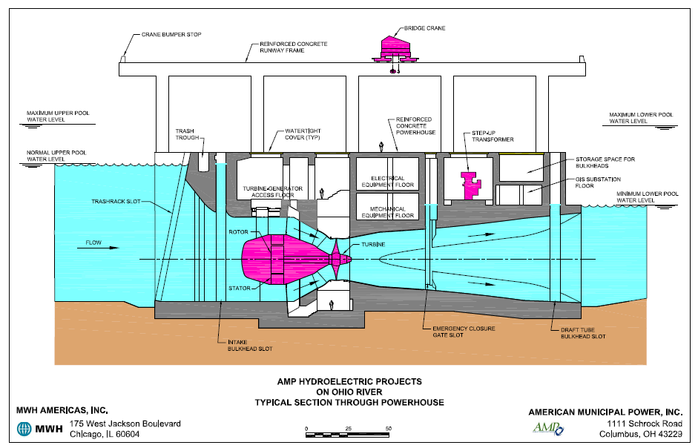
Notes:
Hydro cross section

Slide 71
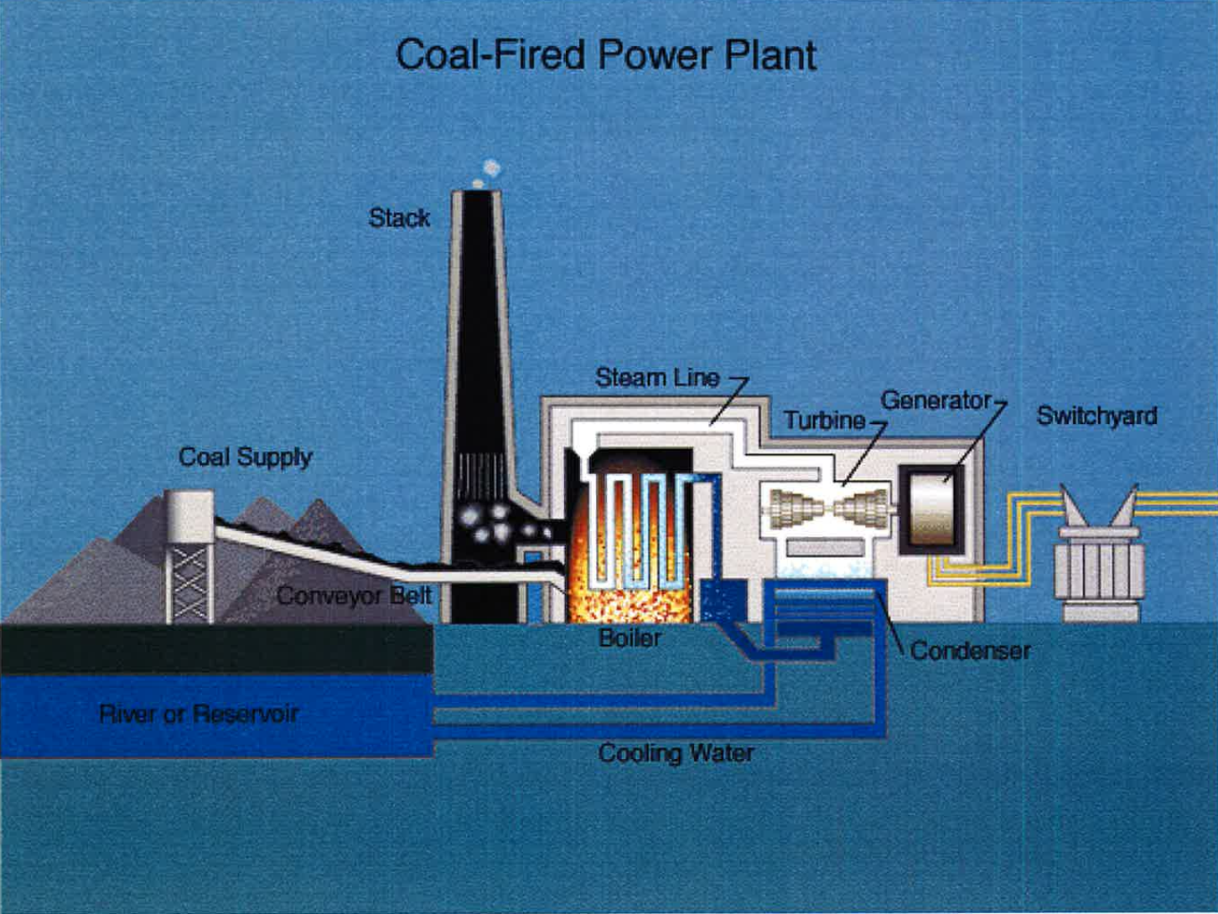

Slide 72
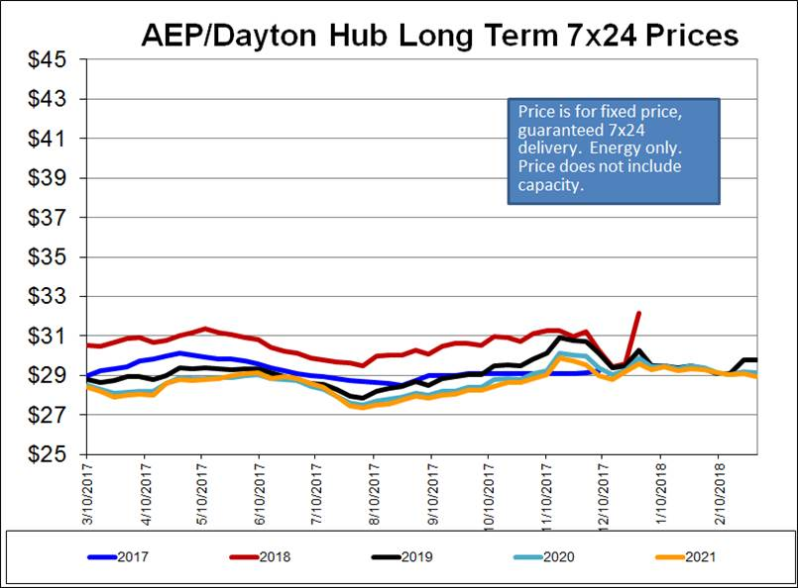
Notes:
Source: AMP

Slide 73
Electric Utility |  |  | 2015 |  | 2016 |  | 2017
 | Electric Utility Operating Revenue: |  | $33,880,064 |  | $35,744,435 |  | $35,209,681
 | Electric Utility Operating Expenses:
 | Administrative & General Payroll |  | $753,261 |  | $783,244 |  | $860,250
 | Technical Services Payroll |  | $563,453 |  | $526,980 |  | $589,730
 | Production - Operational Payroll |  | $1,917,105 |  | $1,804,238 |  | $1760,172
 | Production - Maintenance Payroll |  | $1,457,866 |  | $1,304,731 |  | $1,118,172
 | Distribution - Maintenance Payroll |  | $1,048,736 |  | $984,225 |  | $1,081,387
 | Other Administrative & General Payroll |  | $543,792 |  | $370,447 |  | $347,183
 | Other Production - Operational |  | $1,486,082 |  | $1,720,569 |  | $736,458
 | Purchased Power |  | $9,971,504 |  | $12,603,063 |  | $17,730,269
 | Coal |  | $7,478,493 |  | $6,539,541 |  | $1,438,459
 | Natural Gas |  | $75,007 |  | $336,381 |  | $2,570,167
 | Other Production - Maintenance |  | $672,854 |  | $2,323,507 |  | $955,246
 | Other Distribution - Maintenance |  | $331,035 |  | $358,136 |  | $475,199
 | Total Operating Expenses |  | $26,224,181 |  | $29,318,681 |  | $29,662,692
 | Debt Service |  | $0 |  | $0 |  | $0
 | Transfers |  | $6,628,857 |  | $6,568,729 |  | $3,324,863
Notes:
2016 revenues slightly lower due to wholesale sales. P/R up in 2017 due to retirement payouts.
Total expenses up slightly due to last hydro project coming on line. Retail kWh sales up slightly. We are attempting to re-align our resource portfolio.
Payroll decreasing as most jobs have not been replaced. Power Plant Operations & Maintenance are still being cross-trained.

Slide 74
Water Utility |  |  | 2015 |  | 2016 |  | 2017
 | Water Utility Operating Revenue: |  | $3,277,580 |  | $3,346,504 |  | $2,968,178
 | Water Utility Operating Expenses:
 | Administrative & General Payroll |  | $285,556 |  | $301,821 |  | $320,857
 | Production - Operational Payroll |  | $365,632 |  | $420,854 |  | $376,889
 | Production - Maintenance Payroll |  | $166,114 |  | $169,695 |  | $166,742
 | Distribution - Maintenance Payroll |  | $154,229 |  | $165,698 |  | $156,987
 | Other Administrative & General |  | $91,761 |  | $99,659 |  | $119,249
 | Other Production - Operational |  | $604,679 |  | $625,811 |  | $450,561
 | Other Production - Maintenance |  | $67,477 |  | $384,070 |  | $37,436
 | Other Distribution - Maintenance |  | $32,439 |  | $37,196 |  | $50,341
 | Total Operating Expenses |  | $1,767,887 |  | $2,204,804 |  | $1,679,062
 | Debt Service |  | $737,665 |  | $841,364 |  | $543,178
 | Transfers |  | $909,697 |  | $572,145 |  | $36,000
Notes:
Revenues lower mainly due to power plant changes. The new rate plan will allow us to address the loss of income from the Power Plant, pay for the High St water main replacement
and provide for the needed upkeep of the Water plant.

Slide 75
Wastewater Utility |  |  | 2015 |  | 2016 |  | 2017
 | Wastewater Utility Operating Revenue: |  | $2,265,043 |  | $2,412,957 |  | $2,125,457
 | Wastewater Utility Operating Expenses:
 | Administrative & General Payroll |  | $287,084 |  | $302,027 |  | $324,537
 | Treatment - Operational Payroll |  | $504,026 |  | $497,425 |  | $528,256
 | Treatment - Maintenance Payroll |  | $253,450 |  | $321,938 |  | $241,337
 | Collection - Maintenance Payroll |  | $51,202 |  | $61,940 |  | $46,738
 | Other Administrative & General |  | $94,069 |  | $97,830 |  | $102,421
 | Other Treatment - Operational |  | $332,558 |  | $359,759 |  | $216,578
 | Other Treatment - Maintenance |  | $95,902 |  | $119,485 |  | $161,084
 | Other Collection - Maintenance |  | $23,357 |  | $6,906 |  | $36,802
 | Total Operating Expenses |  | $1,641,648 |  | $1,767,310 |  | $1,675,753
 | Debt Service |  | $0 |  | $0 |  | $0
 | Transfers |  | $306,487 |  | $384,540 |  | $436,782
Notes:
Revenue’s have been flat. 2016 was higher only due to higher than normal industrial customer penalties.
General recap (All Utilities)
-Total payroll down 1%.
-Total spending down 14.5%.
-Total receipts down 4%.
-Gradall’s shut-down will result in ~$650k annual loss in electric revenues, ~$20k each in Water & Wastewater. More significant impact on City income taxes.

Slide 76
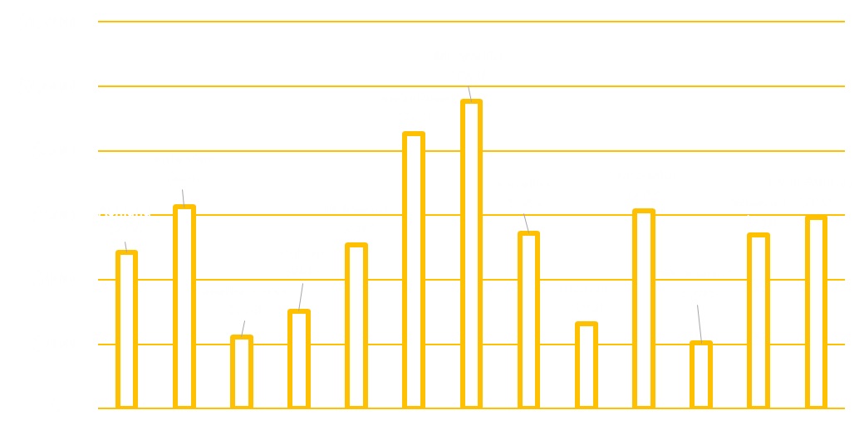
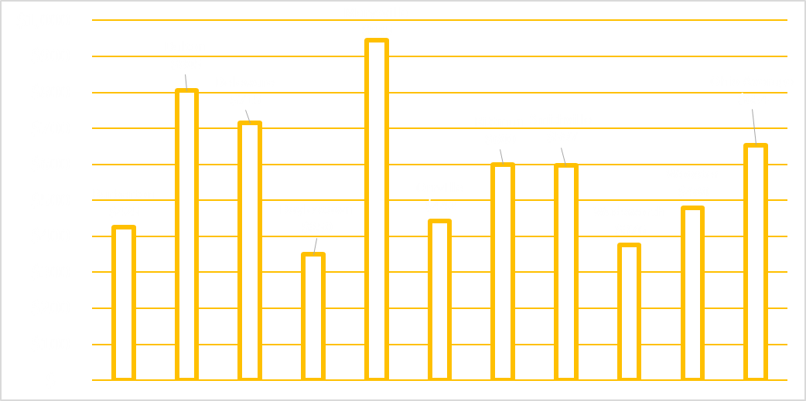

Comparison - Ohio EPA Rate Survey
Water and Wastewater Annual Cost
WATER
WASTEWATER
Items that Influence Rates
Treatment processes and quality
Age of infrastructure / maintenance
Number of customers
Grant Proceeds for capital improvement
Notes:
From Board & City Council work shop presentation.
Since we implemented our new rate plans, both Wooster & Wadsworth are in process in implementing new rates. Wadsworth data for 2017 is not correct (higher). Dalton announced water rate increases 34% in year 1, 1.5, 1.5 ,2.0 ,2.5% in year 5.
State average Water $628 (Orrville $631 includes 14.71/mo capacity charge), Wastewater $661 (Orrville $517 includes 10.74/mo capacity charge)
From W/WW Study for Board & City Council work shop presentations.

Slide 77
Cents/kWh
Notes:
Source: APPA

Slide 78
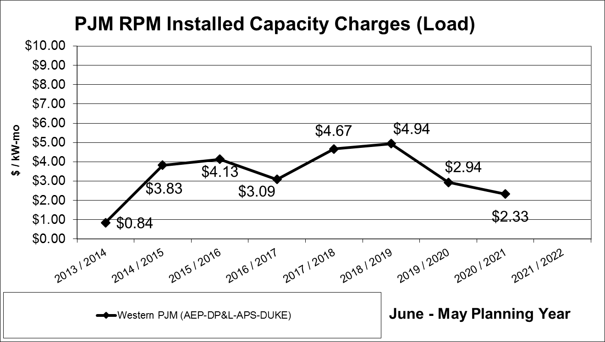
Installed Capacity
Gen Retirements
FE = $8.91 in 15/16
Lower Loads & New Generation
Tighter Rules
Notes:
Insert after Transmission fees & credit slide.
Shows just how volatile the market is and why our costs and credits swing year to year.
2017-2019 period is when the balance of the larger coal plants are scheduled to retire due to regulations. Good thing natural gas is stepping in and everyone is choking down the increased transmission costs. Who knows what we would be paying if the shale plays were not in the picture. New, behind the meter distributed generation (being installed by customers to lower their exposure to the transmission fees) is also contributing to lower charges. PJM sees this as ‘lower loads’ and thus less strain on the grid.
Source: AMP

Slide 79
Notes:
This was the general picture up to 2012.
Orrville’s power supply was only from our power plant up to 1978 when the connection was made to the grid. Low cost fuel kept us in the game for nearly a century and there was not much need to look at diversifying.
That has radically been changing over the recent years due to new energy policies, environmental regulations and new natural gas sources in US.
We can supply 100% of our needs (a huge benefit that few cities have).
Excess capacity is sold into wholesale markets to generate additional revenue but on a much more limited basis due to new EPA regulations and operating restrictions in 2016.

Slide 80
Notes:
This was the general picture up to 2012.
All of Orrville’s power supply was from the power plant up to 1978 when the connection was made to the grid. Low cost fuel kept us in the game for nearly a century and there was not much need to look at diversifying.
That has radically been changing over the recent years due to new energy policies, environmental regulations and new natural gas sources in US impacting market costs.
We can supply 100% of our needs (a huge benefit that few cities have).
Excess capacity is still sold into wholesale markets to generate additional revenue but on a much more limited basis due to new EPA regulations and operating restrictions imposed in 2016.
For Energy Resources in 2018-
Note decrease in Power Plant generation, increase in hydro & purchase power.
Solar added in January & March 2018.
Renewables now account for 22% of our power supply!
Percentages are based on meeting a 61MW peak.
2018 will be the ‘new normal’.
Diversity is very important (not putting all your eggs in one basket). Each has risk, pro’s & con’s. No perfect combination, sort of like investing.
We utilize many experts to help us determine what’s ‘best’ for us.
Although we’ll have ~22% coming from renewable energy, they are not base load units (only 20-50% capacity factors), and must be ‘backed up’ when the sun doesn’t shine, wind blow or water flow.
From Generation Portfolio report.

Slide 81
Notes:
From Generation Portfolio report.

Slide 82
2016
2017
2018
Notes:
Energy Resources 2016-2018. Prior to 2012, 88% came from Power Plant/coal and 12% from the market.
Note decrease in Power Plant generation, increase in hydro & purchase power.
Solar added in January & March 2018.
Renewables now account for 22% of our power supply!
Percentages are based on meeting a 61MW peak.
2018 will be the ‘new normal’.
Diversity is very important (not putting all your eggs in one basket). Each has risk, pro’s & con’s. No perfect combination, sort of like investing.
We utilize many experts to help us determine what’s ‘best’ for us.
Regulations change, effects of supply & demand are different for each.
Although we’ll have ~22% coming from renewable energy, they are not base load units (only 20-50% capacity factors), and must be ‘backed up’ when the sun doesn’t shine, wind blow or water flow.
From AMP invoice summary report.

Slide 83
Notes:
From Generation Portfolio report.

Slide 84
Notes:
Same as slide in presentation but different format.
This was the general picture up to 2012.
Orrville’s power supply was only from our power plant up to 1978 when the connection was made to the grid. Low cost fuel kept us in the game for nearly a century and there was not much need to look at diversifying.
That has radically been changing over the recent years due to new energy policies, environmental regulations and new natural gas sources in US.
We can supply 100% of our needs (a huge benefit that few cities have).
Excess capacity is sold into wholesale markets to generate additional revenue but on a much more limited basis due to new EPA regulations and operating restrictions in 2016.
Energy Resources in 2018.
Note decrease in Power Plant generation, increase in hydro & purchase power.
Solar added in January & March 2018.
Renewables now account for 22% of our power supply!
Percentages are based on meeting a 61MW peak.
2018 will be the ‘new normal’.
Diversity is very important (not putting all your eggs in one basket). Each has risk, pro’s & con’s. No perfect combination, sort of like investing.
We utilize many experts to help us determine what’s ‘best’ for us.
Regulations change, effects of supply & demand are different for each.
Although we’ll have ~22% coming from renewable energy, they are not base load units (only 20-50% capacity factors), and must be ‘backed up’ when the sun doesn’t shine, wind blow or water flow.
From Generation Portfolio report.

Slide 85
Notes:
After wood fuels, most of the others are 0.2% or less.
In 2017, gas, nuclear and hydro %’s about the same. Coal 24.4%, hydro 8.5%, wind 6.9%, solar 2%.
Most additions in 2017 were gas 49%, wind 29%, solar 20%.
From Electric Generation by Fuel Type 2018 report.

Slide 86
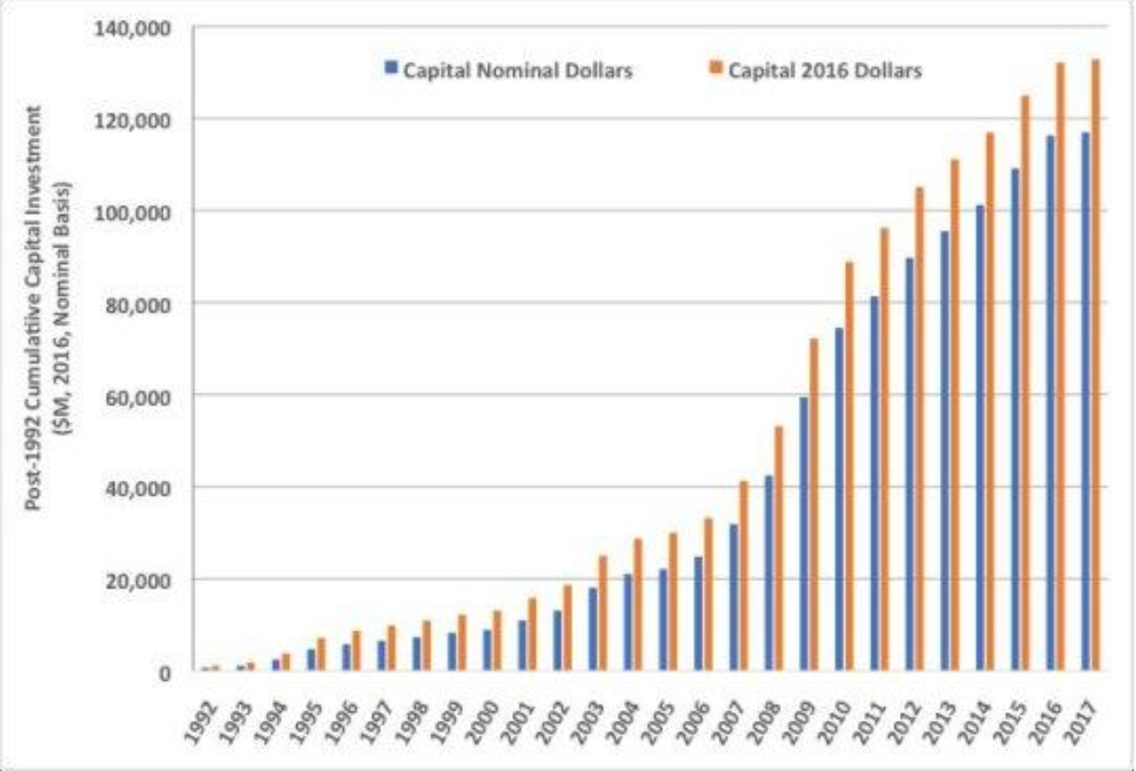
Notes:
Annual expenditure chart used in presentation. This is cumulative/big picture since 1992.
With your money. Scale on the left side is in MILLIONS.
Fig 4-2. Cumulative investment in flue gas enviro controls: Nominal & 2016 basis
I don’t have to remind you who was in the White House from 2009-2016. About $60B was spent during this time.
From Valuing the national investment in coal-based power generation plant air emissions controls report by APPA,EEI,NRECA 2018 report.

Slide 87
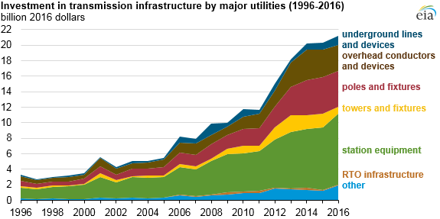
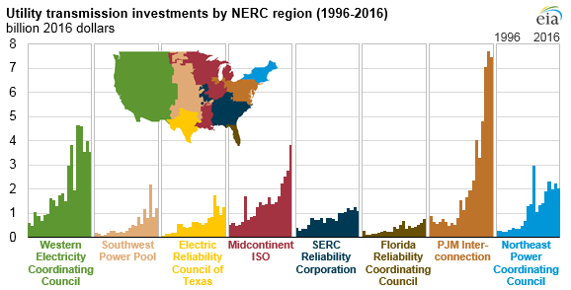
Notes:
We are located in the PJM Interconnection Region.
Source: U.S. Energy Information Administration, Federal Energy Regulatory Commission (FERC) Financial Reports, 2/9/18.
Utilities continue to increase spending on transmission infrastructure report

Slide 88

Notes:
Source: U.S. Energy Information Administration, Annual Energy Outlook 2018

Slide 89

Notes:
From 2016 presentation.
Longer term forecast of energy resources. Remember, having it and having it available when needed are two separate things.
Most is natural gas followed by wind & solar.
Despite their ‘popularity’, coal & nuclear will play significant roles due to their ability to provide 24/7 energy 80-90% of the time.
Source: U.S. Energy Information Administration, Annual Energy Outlook 2017

Slide 90

Source: U.S. Energy Information Administration, International Energy Outlook 2017
Notes:
World consumption not US.
Source: U.S. Energy Information Administration, International Energy Outlook 2017

Slide 91

Notes:
Notice not only the change in resource %’s but the amounts of owned generation. Most IOU’s are divesting their generation plants.
Source: Power magazine April 2018

